Slide 1
Computer Programming in C
An Introduction

Slide 2
Analogy – Teaching kids how to cook
make a boiled egg sandwich
levels of abstraction
as abstract as possible but without ambiguity
complexity is the enemy of the programmer

Slide 3
What is a program?
“A sequence of instructions that a computer can interpret and execute.”
WordNet (Princeton)

Slide 4
What is a programming language?
“A language designed to facilitate the writing of computer programs.”
Collins English Dictionary

Slide 5
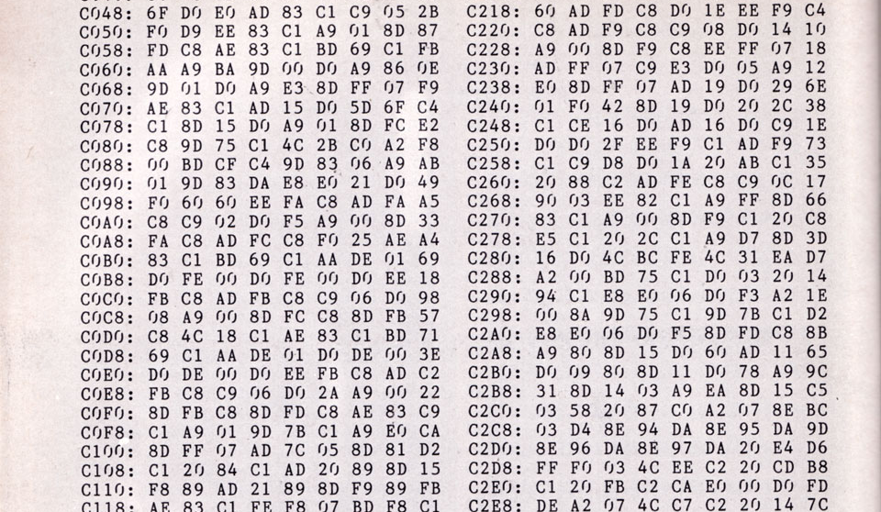
Programming language generations
First generation language features
Machine code (ones and zeros or hex)
instructions executed directly by the CPU
sometimes called “native code”

Slide 6
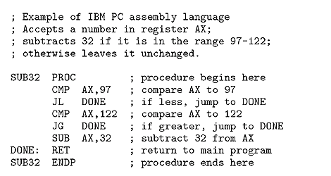
Programming language generations
Second generation language features
assembly languages
low-level languages
converted down to machine code
compare
jump if less than
subtract
return
etc.

Slide 7
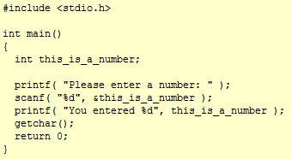
Programming language generations
Third generation language features
high-level languages
functions, named variables, structures
C, C++, Java

Slide 8
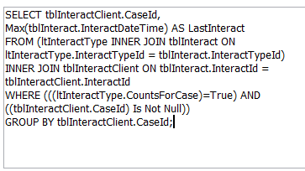
Programming language generations
Fourth generation language features
designed with a particular domain in mind
can be closer to human language
SQL, LabView, R

Slide 9
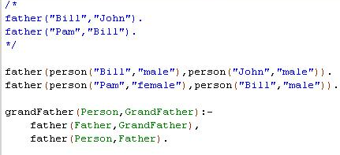
Programming language generations
Fifth generation language features
constraint-based
solve problems without programmers
more for research than practical purposes
Prolog, Mercury

Slide 10
Programming language generations
First generation language disadvantages
very difficult to program
barely readable (and therefore unmaintainable)
specific to CPU

Slide 11
Programming language generations
Second generation advantages (over first)
using languages making it easier to understand
Second generation disadvantages
very difficult to program
barely readable (and therefore unmaintainable)
specific to CPU

Slide 12
Programming language generations
Third generation advantages (over second)
variables, functions and structures
great readability
can apply high-level concepts e.g. inheritance
not specific to CPU
Third generation disadvantages
can be less efficient than lower-level languages
may require long compilation time

Slide 13
Programming language generations
Fourth generation advantages
work very well in their domain
Fourth generation disadvantages
don’t work well in other domains

Slide 14
Programming language generations
Fifth generation advantages
can dynamically infer information
Fifth generation disadvantages
can take a very long time to set up a problem
becomes very hard when problem is large

Slide 15
The C programming language
imperative
stateful
structured
not just a bunch of jumps
40 years old but still used
languages borrowing from C
C++, C#, Go, Java, Javascript and more

Slide 16
System Software
The files and programs that make up an operating system e.g. Windows, Mac OS X, Linux.
interacts with the computer hardware
examples
Graphical User Interface components
debugger, compilers, utilities
provides a platform for application software

Slide 17
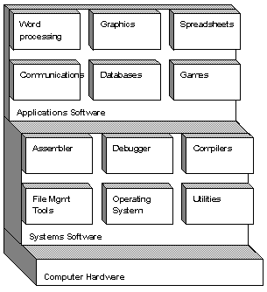
Application Software
programs built upon the system software
enterprise
accounting
office
graphics suites
media players
source: webopedia

Slide 18
Uses of an Integrated Development Environment (IDE)
fast navigation
code completion
automatic code generation
quick refactoring
integrated debugging
class visualization
build automation tools
tell you about errors and warn you

Slide 19
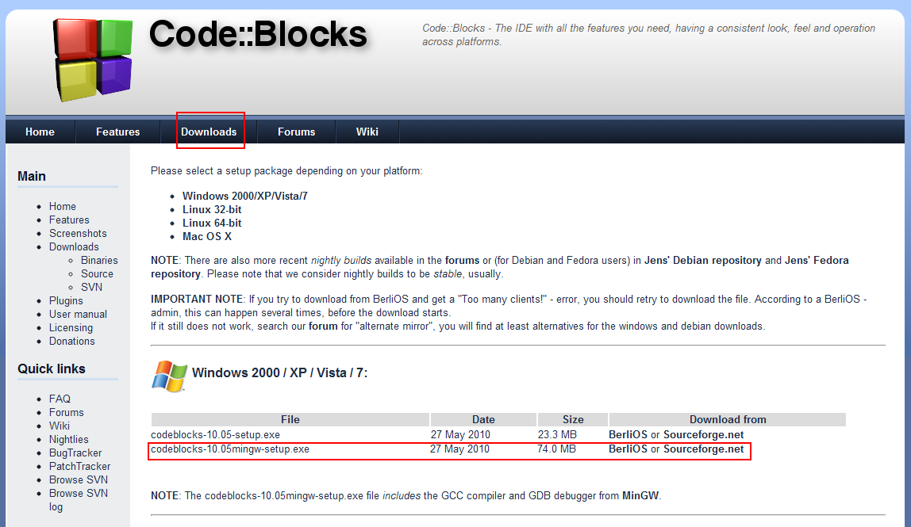
Integrated Development Environment (IDE) with a compiler
programming language to machine language
- source code to object code

Slide 20
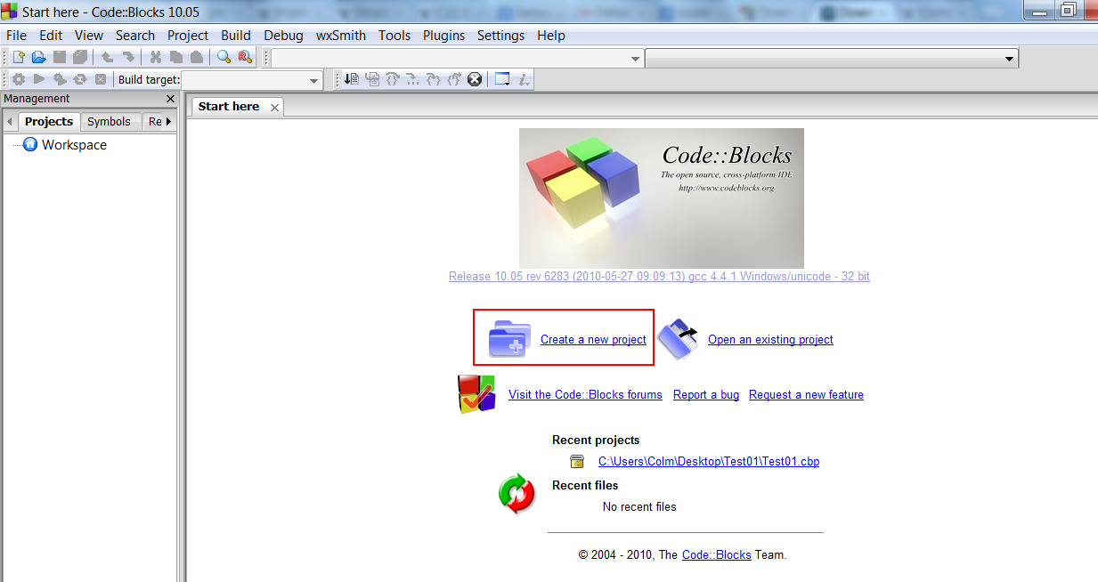
Create a new project

Slide 21
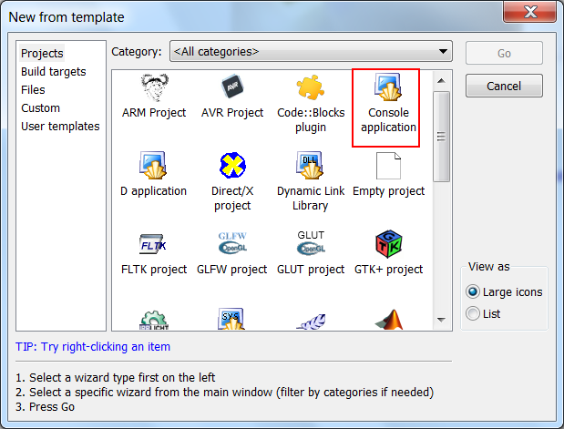
Console Application

Slide 22
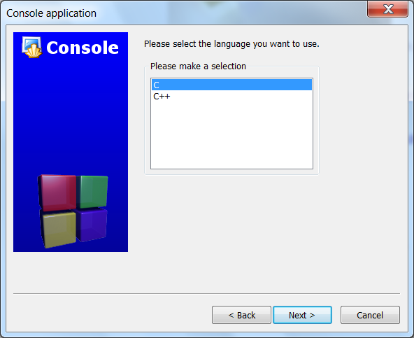
C

Slide 23
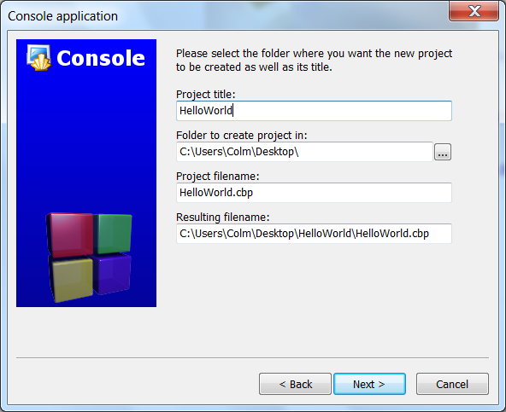
Hello World project

Slide 24
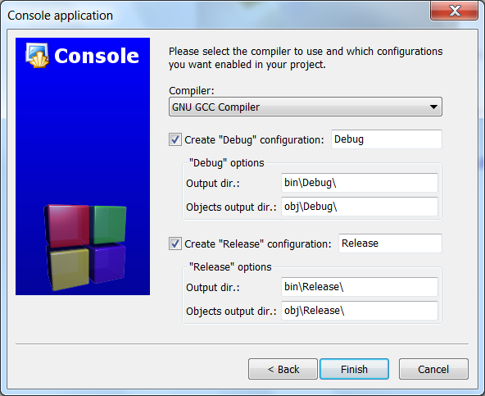
GNU GCC

Slide 25
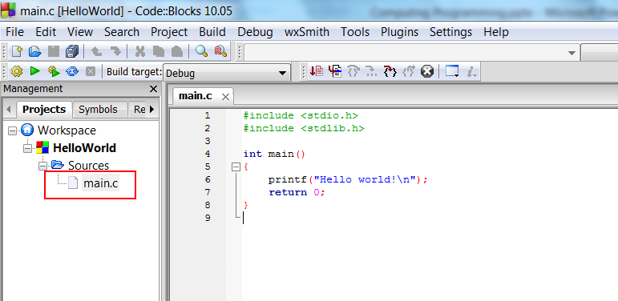
Open source code file

Slide 26
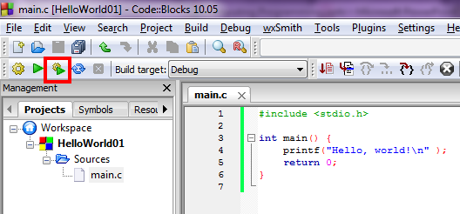
How to compile and run a program

Slide 27
Exercises
find/replace
block copy
block paste
block delete
document your program
usually the “what” and “why” and not the “how”
“how” is fine for beginners

Slide 28
compiler and interpreter
compiler
translates source code into machine code that is saved to a file and can be executed at a later time
can optimize code during compilation
takes time to compile but fast during execution
C and C++ programs need to be compiled
interpreter
takes source code and executes it on the fly
no compile time can mean faster development
usually slower than compiled executables
Python, Ruby, Lua can be interpreted

Slide 29
before we start coding
Git
code versioning software
github.com
style guide
Google C++:
http://google-styleguide.googlecode.com/svn/trunk/cppguide.xml

Slide 30
before we start coding
Input/Output
take input from the user i.e. keyboard input
show user output e.g. “Hello, world!”
cursor and screen handling
the cursor is the arrow on the screen
“reverse video” is the name of the technique where text and text background colour changes when selected

Slide 31
a word of caution
memory management in C
it assumes you know what you’re doing
it assumes you clean up (no garbage collection)
uninitialized variables, improperly ended character strings and out of bounds arrays are problems

Slide 32
the main function
we start reading a book from page one
the program needs to know from where it should start
it starts in the main function
there must be at least one “main” function in each program

Slide 33
the main function
int main() {
return 0;
}
parentheses () follow function name – main
braces {} enclose code to be executed – scope
this is the most bare form
semi-colons end statements
more details on next slide

Slide 34
the main function (with comments)
// any text after two double forward slashes is a single line comment
// comments don’t affect program behaviour
// comments only serve to make programs easier to read
int main()
{ // everything inside this opening brace { is part of the main function
return 0; // returning 0 let’s the computer know nothing went wrong
} // end the main function
// this comment is outside of the closing brace } of the main function and
// therefore isn’t part of the main function

Slide 35
What is a variable?
“able to change or be adapted”
Oxford Dictionary
a symbol associated with a value
types of variables
in C, a data type and symbol associated with a value held in an address in memory

Slide 36
variable declaration
int main() {
// it’s good practice to declare variables at the beginning of a function
int my_integer; // declare an integer variable
return 0;
}
some data types in C
“int” for integers (whole numbers)
“float” for real numbers (whole or non-whole)
“bool” for booleans (true or false)
“char” for characters (letters and symbols)

Slide 37
assignment operator
int main() {
// it’s good practice to declare variables at the beginning of a function
int my_integer; // declare an integer variable
my_integer = 10; // assign (initialize) an integer variable
return 0;
}

Slide 38
declare and assign
int main() {
// it’s good practice to declare variables at the beginning of a function
int my_integer = 10; // declare and assign integer variable
return 0;
}

Slide 39
printf
print formatted text to standard output (console)
like main, printf is a function
it requires at least one parameter – the format string
the format string is a string of characters a.k.a. a string
like main, the function starts with parentheses ()
the function parameters go inside the parentheses

Slide 40
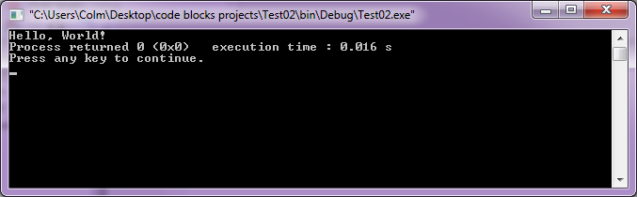
printf
int main() {
printf("Hello, World!");
return 0;
}

Slide 41
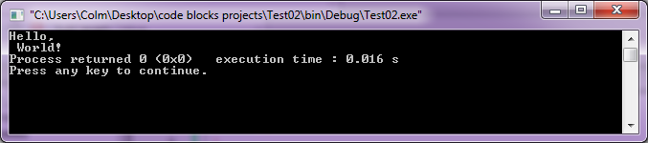
printf with line breaks
put “\n” anywhere in the format string to cause a line break in the console
similar to a carriage return in a text editor
int main() {
printf("Hello,\n World!");
return 0;
}

Slide 42
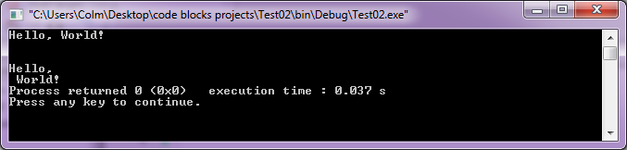
multiple printf calls
call functions as many times as you like
int main() {
printf("Hello, World!\n\n\n");
printf("Hello,\n World!");
return 0;
}

Slide 43
printf with variables
format of values variables are specified using % tokens e.g. %i for integers
the % tokens are replaced by the formatted value of the corresponding variable
parameters after the format string are values or variables
parameters are separated by commas ,

Slide 44
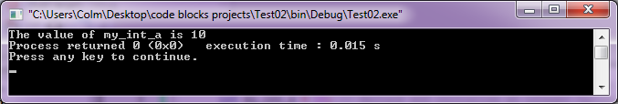
printf with variables
int main() {
// it’s good practice to declare variables at the beginning of a function
int my_int_a = 10; // declare and initialize an integer variable
printf("The value of my_int_a is %d", my_int_a);
return 0;
}

Slide 45
printf with variables
token
variable
1
1
printf("The value of my_int_a is %d", my_int_a);
The value of my_int_a is 10
substitution

Slide 46
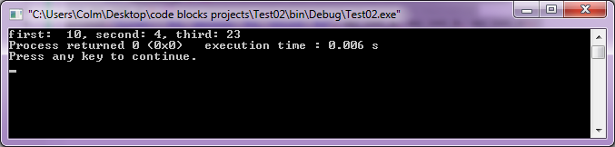
printf with variables
int main() {
int my_int_a = 10; // declare and initialize an integer variable
int my_int_b = 4; // declare and initialize an integer variable
int my_int_c = 23; // declare and initialize an integer variable
printf("first: %d, second: %d, third: %d", my_int_a, my_int_b, my_int_c);
return 0;
}

Slide 47
printf with variables
tokens
variables
1
2
3
1
2
3
printf("first: %d, second: %d, third: %d", my_int_a, my_int_b, my_int_c);
first: 10, second: 4, third: 23
substitution

Slide 48
addition operator
#include <stdio.h>
int main() {
// notice that variables are declared at the start
int a = 2; // create an integer variable
int b = 3; // create an integer variable
int my_sum = a + b; // add two integers
printf("The sum of a and b is %d", my_sum);
return 0;
}

Slide 49
subtract operator
#include <stdio.h>
int main() {
// notice that variables are declared at the start
int a = 2; // create an integer variable
int b = 3; // create an integer variable
int my_sum = b - a; // add two integers
printf(“b minus a is %d", my_sum);
return 0;
}

Slide 50
add and subtract exercise
Write a program that gives an integer variable any value you like e.g. 10, and prints it out. Then print out a variable 2 higher than that number e.g. 12, using the addition operator. Print out that value too. Finally subtract 5 using the subtraction operator and print out the final variable value e.g. 7.

Slide 51
add and subtract exercise solution
#include <stdio.h>
int main() {
int a = 10;
int b;
int c;
b = a + 2;
c = b - 5;
printf("a has a value of %d\n", a);
printf("b has a value of %d\n", b);
printf("c has a value of %d\n", c);
return 0;
}

Slide 52
multiply
#include <stdio.h>
int main() {
int a = 2; // create an integer variable
int b = 3; // create an integer variable
int c = a * b; // multiply two integers
printf("The product of %d and %d is %d", a, b, c);
return 0;
}

Slide 53
division
#include <stdio.h>
int main() {
int a = 6; // create an integer variable
int b = 3; // create an integer variable
int c = a / b; // divide one integer by another
printf("%d divided by %d is %d", a, b, c);
return 0;
}

Slide 54
integer division can be strange
#include <stdio.h>
int main() {
int a = 7; // create an integer variable
int b = 3; // create an integer variable
int c = a / b; // divide
printf("%d divided by %d is %d", a, b, c);
return 0;
}

Slide 55
floating point division
#include <stdio.h>
int main() {
float a = 7; // create a floating point variable
float b = 3; // create a floating point variable
float c = a / b; // divide
printf("%f divided by %f is %f", a, b, c);
return 0; //return a value
} // end the function

Slide 56
floating point decimal places
#include <stdio.h>
int main() {
float a = 7; // create a floating point variable
float b = 3; // create a floating point variable
float c = a / b; // divide
printf("%.2f divided by %.2f is %.3f", a, b, c);
return 0; //return a value
} // end the function

Slide 57
booleans and relational operators
a boolean can be false or true (0 or 1)
relational operators
2 < 3
4 == 4
symbol | operator
< | less than
> | greater than
<= | less than or equal to
>= | greater than or equal to
== | equal to
!= | not equal to

Slide 58
if statements
if x then y
if conditions are satisfied then execute effects
condition is inside parentheses ()
executed code is contained within braces {}
the braces define the scope of the if statement
all code in the scope of the if statement is executed if the condition of the if statement is satisfied

Slide 59
if statement pseudo-code
if (condition) // condition must be true to enter the if
{ // open the scope of the if statement
code to be executed if the condition is satisfied
} // close of the scope of the if statement
Note that the brace { can be on the same line as the closing parenthesis ) or on the next line and still have the same effect. I have it on the next line to fit a comment beside it but we’ll usually put them on the same line.

Slide 60
if statements
#include <stdio.h>
int main() {
int a = 7; // create an integer variable
if (a < 10) { // if a is less than 10, begin executed the if code
printf("%d is less than 10", a); // inside the if
} // end the scope of the if statement
printf("This will always be printed"); // outside of if statement
return 0;
}

Slide 61
if statement exercise
Write a grading program that will output “You got an A” if the tested variable is greater than 90.

Slide 62
if statement exercise solution
#include <stdio.h>
int main() {
int a = 91;
if (a > 90) {
printf("You got an A");
}
return 0;
}

Slide 63
else if statement
else if statements allow a chain of if statement to be checked in sequence
if the first if statement isn’t true, check the second. If that isn’t true, check the third. If the third is true, don’t check any of the any else if statements

Slide 64
else if statement pseudo-code
if (condition_a) {
code executed if condition a is true
}
else if (condition_b) {
code executed if condition a was false and b is true
}
else if (condition_c) {
code executed if conditions a and b were false but c is true
}

Slide 65
else if statements
#include <stdio.h>
int main() {
int a = 7;
if (a < 10) { // if a is less than 10
printf("%d is less than 10", a);
}
else if (a == 10) { // if a equals 10
printf("a is exactly 10");
}
else if (a >= 13) { // else if a is greater than or equal to 13
printf("%d is greater than or equal to 13", a);
}
return 0;
}

Slide 66
else if statements
#include <stdio.h>
int main() {
int a = 7;
if (a < 10) {
printf("%d is less than 10", a);
}
else if (a == 10) {
printf("a is exactly 10");
}
else if (a >= 13) {
printf("%d is greater than or equal to 13", a);
}
return 0;
}
if this condition is satisfied

Slide 67
else if statements
#include <stdio.h>
int main() {
int a = 7;
if (a < 10) {
printf("%d is less than 10", a);
}
else if (a == 10) {
printf("a is exactly 10");
}
else if (a >= 13) {
printf("%d is greater than or equal to 13", a);
}
return 0;
}
execute this

Slide 68
else if statements
#include <stdio.h>
int main() {
int a = 7;
if (a < 10) {
printf("%d is less than 10", a);
}
else if (a == 10) {
printf("a is exactly 10");
}
else if (a >= 13) {
printf("%d is greater than or equal to 13", a);
}
return 0;
}
otherwise

Slide 69
else if statements
#include <stdio.h>
int main() {
int a = 7;
if (a < 10) {
printf("%d is less than 10", a);
}
else if (a == 10) {
printf("a is exactly 10");
}
else if (a >= 13) {
printf("%d is greater than or equal to 13", a);
}
return 0;
}
if this condition is true

Slide 70
else if statements
#include <stdio.h>
int main() {
int a = 7;
if (a < 10) {
printf("%d is less than 10", a);
}
else if (a == 10) {
printf("a is exactly 10");
}
else if (a >= 13) {
printf("%d is greater than or equal to 13", a);
}
return 0;
}
execute this code

Slide 71
else if statements
#include <stdio.h>
int main() {
int a = 7;
if (a < 10) {
printf("%d is less than 10", a);
}
else if (a == 10) {
printf("a is exactly 10");
}
else if (a >= 13) {
printf("%d is greater than or equal to 13", a);
}
return 0;
}
but if this is also not satisfied

Slide 72
else if statements
#include <stdio.h>
int main() {
int a = 7;
if (a < 10) {
printf("%d is less than 10", a);
}
else if (a == 10) {
printf("a is exactly 10");
}
else if (a >= 13) {
printf("%d is greater than or equal to 13", a);
}
return 0;
}
check the next else if and so on

Slide 73
else if statement exercise
write a grading program that will output a grade for each of the following situations:
“You got an A” - grade greater than 90
“You got an B” - grade from 80 to 89
“You got an C” - grade from 70 to 79
“You got an D” - grade from 60 to 69
“You got an F” - grade less than 60

Slide 74
else if statements exercise solution
#include <stdio.h>
#include <stdlib.h>
int main()
{
int grade = 60;
if (grade >= 90) {
printf("You got an A");
}
else if (grade >= 80) {
printf("You got an B");
}
else if (grade >= 70) {
printf("You got an C");
}
else if (grade >= 60) {
printf("You got an D");
}
else if (grade < 60) {
printf("You got an F");
}
return 0;
}

Slide 75
indentation
starting a line of text further from the margin than the enclosing structures line of text
opening brace ,{, means indentation should begin
closing brace, }, means indentation should end
the line of text of the enclosing structure should line up with its closing brace

Slide 76
indentation
#include <stdio.h>
int main() { // opening braces means we should indent
int a = 7; // create an integer variable
if (a < 10) { // opening braces means we should indent
printf("print something");
printf("print something");
printf("print something");
} // closing brace means we should reduce indention
else if (a >= 13) {
print("something else");
}
return 0; //return a value
} // reduce indentation

Slide 77
style
we’ll follow these conventions
declare variables at the beginning of a function
variable names will underscore to separate words e.g. my_integer_a
same for functions e.g. my_function_x
no spaces before or after parentheses e.g. (first, second, third), not ( first, second, third )
one space to separate parameters
one space between operators and operands e.g. a < b
every control structure, e.g. if and while, must use curly braces
curly braces are on the same line as their structure
only have one statement on each line

Slide 78
else
if neither the if statement not the else if conditions were satisfied, execute some particular code
no parentheses because it has no condition to satisfy
just as with the if statement, braces {} define its scope

Slide 79
else pseudo-code 1
if (condition_a) {
code executed if condition a is true
}
else {
code executed if condition a is false
}

Slide 80
else pseudo-code 2
if (condition_a) {
code executed if condition a is true
}
else if (condition_b) {
code executed if condition a is false and b is true
}
else {
code executed if conditions a and b were false
}

Slide 81
else statements
#include <stdio.h>
int main() {
int a = 7; // create an integer variable
if (a < 10) { // if a is less than 10
printf("%d is less than 10", a);
}
else if (a == 10) {
printf("a is exactly 10");
}
else if (a >= 13) { // else if a is greater than or equal to 13
printf("%d is greater than or equal to 13", a);
}
else { // for all other situations
printf("%d is a value from 10 to 12", a);
}
return 0; //return a value
} // end the function

Slide 82
else statements
#include <stdio.h>
int main() {
int a = 7; // create an integer variable
if (a < 10) { // if a is less than 10
printf("%d is less than 10", a);
}
else if (a == 10) {
printf("a is exactly 10");
}
else if (a >= 13) { // else if a is greater than or equal to 13
printf("%d is greater than or equal to 13", a);
}
else { // for all other situations
printf("%d is a value from 10 to 12", a);
}
return 0; //return a value
} // end the function
if all conditions are unsatisfied
execute code in the
else scope

Slide 83
else statement exercise
Write a program that will print out “The integer value is greater than 100” if an integer variable has a value greater than 100. Otherwise, print “The integer value is not greater than 100”.

Slide 84
scanf
allows formatted input to be taken from the user
uses the same tokens as printf e.g. %d for integers, %f for floats etc.
requires at least two parameters
the format string
the variable to give the formatted value to
unlike printf, scanf requires ampersand (&) before variable being given a value

Slide 85
scanf to take user input
#include <stdio.h>
int main() {
int my_integer;
printf("Input a number: "); // tell the user what to do
scanf("%d", &my_integer);
printf("You entered the number %d", my_integer);
return 0;
}

Slide 86
scanf exercise 1
Take an integer from the user. Output the value of their input plus 10.

Slide 87
scanf exercise 1 solution
#include <stdio.h>
int main() {
int user_integer;
int final;
printf("Input an integer: "); // tell the user what to do
scanf("%d", &user_integer);
final = user_integer + 10;
printf("The final number is %d", final);
return 0;
}

Slide 88
scanf exercise 2
Take two integers from the user. Output the value of these two numbers multiplied by each other.

Slide 89
scanf exercise 2 solution
#include <stdio.h>
int main() {
int factor1;
int factor2;
int product;
printf("Input the first integer factor: ");
scanf("%d", &factor1);
printf("Input the second integer factor: ");
scanf("%d", &factor2);
product = factor1 * factor2;
printf("The product of %d and %d is %d", factor1, factor2, product);
return 0;
}

Slide 90
scanf exercise 3
Take two floats from the user. Output their average value.
Hint: their average will also be a float.
Hint: get the average of two numbers by dividing their sum by two.
Hint: use %f for floats

Slide 91
scanf exercise 3 solution
#include <stdio.h>
int main() {
float user_input1;
float user_input2;
float average;
printf("Input the first float: ");
scanf("%f", &user_input1);
printf("Input the second float: ");
scanf("%f", &user_input2);
average = (user_input1 + user_input2) / 2;
printf("The average of %f and %f is %f", user_input1, user_input2, average);
return 0;
}

Slide 92
scanf exercise 4
Take two floats from the user. Output their average value. Also output a message saying whether or not the average is greater than 50.

Slide 93
scanf exercise 4 solution
#include <stdio.h>
int main() {
float user_input1;
float user_input2;
float average;
printf("Input the first float: ");
scanf("%f", &user_input1);
printf("Input the second float: ");
scanf("%f", &user_input2);
average = (user_input1 + user_input2) / 2;
printf("The average of %f and %f is %f", user_input1, user_input2, average);
if (average > 50) {
printf("The average is greater than 50");
}
return 0;
}

Slide 94
scanf exercise 5
Take the height and weight of a user. Find which BMI using information found online to perform the calculation. Output the user’s BMI and which BMI category they fit into.
Hint: use floats for all variables.

Slide 95
scanf exercise 5 solution
#include <stdio.h>
int main() {
float mass_kg;
float height_m;
float bmi;
printf("Input your weight in kilograms: ");
scanf("%f", &mass_kg);
printf("Input the height in meters: ");
scanf("%f", &height_m);
bmi = mass_kg / (height_m * height_m);
printf("Your BMI is %f \n", bmi);
if (bmi < 18.5) {
printf("You are in the underweight category");
}
else if (bmi < 25) {
printf("You are in the normal weight category");
}
else if (bmi < 30) {
printf("You are in the overweight category");
}
else {
printf("You are in the obese category");
}
return 0;
}

Slide 96
debugging
“Identify and remove errors from (computer hardware or software)”.
Oxford Dictionary
a debugger will let a user step through a program to view code execution line by line
CodeBlocks has a built in debugger

Slide 97
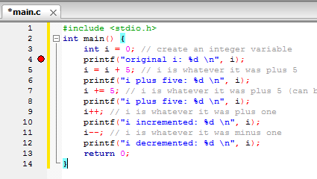
debugging
insert a break point – the position the program will pause execution
left-click to the right of the line number at which you want to pause execution
a red circle should appear

Slide 98
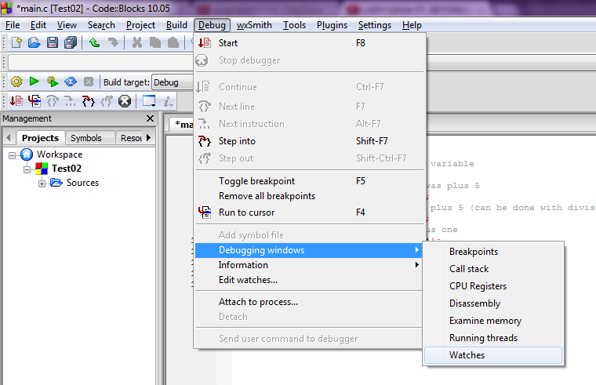
debugging
make the debug watcher window visible

Slide 99
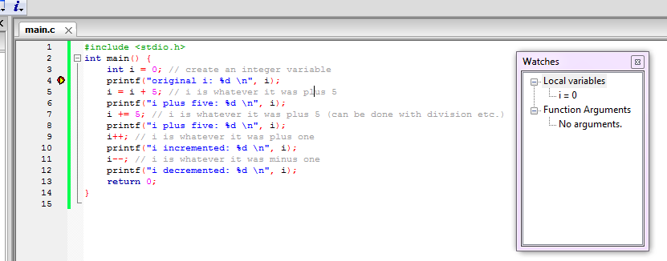
debugging
run the program either by selecting “Start” from the “Debug” menu or by using the F8 keyboard shortcut

Slide 100
debugging
press F7 to execute the program one line at a time
local variables will be highlighted red if a statement changes them

Slide 101
changing a variable value
#include <stdio.h>
int main() {
int i = 0; // create an integer variable
printf("original i: %d \n", i);
i = i + 5; // i is whatever it was plus 5
printf("i plus five: %d \n", i);
i += 5; // i is whatever it was plus 5 (can be done with division etc.)
printf("i plus five: %d \n", i);
i++; // i is whatever it was plus one
printf("i incremented: %d \n", i);
i--; // i is whatever it was minus one
printf("i decremented: %d \n", i);
return 0;
}

Slide 102
clearing screen and pausing (Windows)
#include <stdio.h>
int main() {
int i = 0; // create an integer variable
printf("original i: %d \n", i);
system("pause"); // pause program execution
system("cls"); // clear the screen
i = i + 5; // i is whatever it was plus 5
printf("i plus five: %d \n", i);
i += 5; // i is whatever it was plus 5 (can be done with division etc.)
printf("i plus five: %d \n", i);
i++; // i is whatever it was plus one
printf("i incremented: %d \n", i);
i--; // i is whatever it was plus one
printf("i decremented: %d \n", i);
return 0;
}

Slide 103
while loop
an if statement that will keep executing if the condition is always satisfied
useful for when we want to execute the same code repeatedly
just like an if statement, its condition is contained within parentheses () and its scope by braces {}

Slide 104
while loop
while (guard condition) {
code to execute while guard is true
}
some code after the while loop
guard condition evaluated
if guard condition is true, goto step 3, otherwise, goto step 6
execute code inside the while loop
goto step 2
while loop is finished. Execute whatever code comes after loop

Slide 105
while loop
#include <stdio.h>
int main() {
int i = 0; // declare and initialize an integer i
while (i < 5) { // guard: only continue to loop when i is less than 5
i++; // increment i (progress towards termination)
printf("Number of times in the loop is %d \n", i);
} // end while scope
return 0;
}
beware of infinite loops!

Slide 106
sentinel value
A sentinel is a special value used to guarantee the possible termination of a loop
It is useful when the number of inputs isn’t known in advance
For example, continue adding numbers until the sentinel value is entered
int main() {
int user_input = 0;
int sum = 0;
int sentinel_value = -1;
printf("Please enter a positive number to be added to the sum" );
printf(" or -1 to quit: ");
while (user_input != sentinel_value) {
sum += user_input;
scanf("%d", &user_input);
}
printf("\nSum: %d", sum);
return 0;
}

Slide 107
while loop exercise 1
Using a while loop, output all multiples of 5 than are less than 100 and greater than 0 e.g. 5, 10, 15, …, 90, 95

Slide 108
while loop exercise 1 solution
#include <stdio.h>
#include <stdlib.h>
int main()
{
int multiple_of_five = 5;
while (multiple_of_five < 100) {
printf("multiple_of_five: %d \n", multiple_of_five);
multiple_of_five += 5;
}
return 0;
}

Slide 109
while loop exercise 2
The user must guess the secret number of your choosing. Ask the user to input a number from 1 to 10 as their guess. If they guessed incorrectly, tell them they are wrong. If they guessed correctly, tell them they are right and end the loop.

Slide 110
while loop exercise 2 solution
#include <stdio.h>
#include <stdlib.h>
int main()
{
int guess;
int secret_number = 5; // could have been 1 to 10
printf("Guess my number from 1 to 10: ");
scanf("%d", &guess);
while (guess != secret_number) {
printf("\nWrong! Guess again: ");
scanf("%d", &guess);
}
printf("\nYou guessed correctly!");
return 0;
}

Slide 111
while loop exercise 3
using a while loop, take 5 numbers from the user and output their sum

Slide 112
while loop exercise 3 solution
#include <stdio.h>
#include <stdlib.h>
int main()
{
int sum = 0;
int numeric_input;
int num_inputs_taken = 0;
while (num_inputs_taken < 5) {
printf("\nPlease input a number: ");
scanf("%d", &numeric_input);
sum += numeric_input;
num_inputs_taken++;
}
printf("\nThe sum of the five numbers is: %d", sum);
return 0;
}

Slide 113
while loop exercise 4
using a while loop, keep taking numbers until the sum is greater than 99.

Slide 114
while loop exercise 4 solution
#include <stdio.h>
#include <stdlib.h>
int main()
{
int sum = 0;
int numeric_input;
while (sum < 100) {
printf("\nPlease input a number: ");
scanf("%d", &numeric_input);
sum += numeric_input;
}
printf("\nThe sum of all of the numbers is: %d", sum);
return 0;
}

Slide 115
top-down development
starts with an overview concept of a system
concept is continually decomposed in less abstract, more refined concepts
Refining and decomposition continues the concept no longer needs refinement
In computer programming, this point is usually the level of a single function (later)
promotes modular development and helps designer to consider system constraints sooner

Slide 116
top-down example
IDE
settings
plugin system
bookmark manager
…
UI
text editor
syntax highlighter
…
project explorer
build output
…

Slide 117
C standard boolean
C doesn’t have a primitive boolean type
include standard header file
#include <stdbool.h>
#include <stdio.h>
int main() {
bool b = true;
if (b == true) {
printf("b is true \n");
}
int x = 1;
int y = 2;
b = x > y;
if (b == true) {
printf("b is still true");
}
else {
printf("b is now false");
}
return 0;
}

Slide 118
boolean operators
symbol | operator name | effect
&& | AND | conjunctive
¦¦ | OR | disjunctive
! | NOT | negation

Slide 119
compound boolean expressions
#include <stdbool.h>
#include <stdio.h>
int main() {
bool p;
bool q;
bool r;
bool b;
p = false;
q = false;
b = p || q;
printf("%d OR %d: %d \n", p, q, b);
p = false;
q = true;
b = p || q;
printf("%d OR %d: %d \n", p, q, b);
p = true;
q = true;
b = p || q;
printf("%d OR %d: %d \n", p, q, b);
p = false;
q = !p;
b = p || q;
printf("%d OR %d: %d \n", p, q, b);
p = false;
q = true;
b = p && q;
printf("%d AND %d: %d \n", p, q, b);
p = true;
q = !p;
r = true;
b = p && q || r;
printf("%d AND %d OR %d: %d \n", p, q, r, b);
return 0;
}
if it’s raining and you have an umbrella and you’re outside then use the umbrella
if you are hungry and have a sandwich or baguette then eat

Slide 120
compound boolean expressions
code samples
#include <stdio.h>
#include <stdlib.h>
#include <stdbool.h>
int main()
{
bool is_raining = true;
bool has_umbrella = true;
bool is_outside = true;
if (is_raining && has_umbrella && is_outside) {
printf("Use umbrella\n");
}
bool is_hungry = true;
bool has_sandwich = false;
bool has_baguette = true;
if (is_hungry && (has_sandwich || has_baguette)) {
printf("Eat lunch");
}
return 0;
}

Slide 121
truth tables
table showing logical possibilities for a set of propositions
p | q | p AND q
0 | 0 | 0
0 | 1 | 0
1 | 0 | 0
1 | 1 | 1
try the truth table for p OR q
try for all variations of NOT and AND

Slide 122
truth tables
p | q | p OR q
0 | 0 | 0
0 | 1 | 1
1 | 0 | 1
1 | 1 | 1
p | q | !p | !q | p AND q | !p AND q | p AND !q | !p AND !q
0 | 0 | 1 | 1 | 0 | 0 | 0 | 1
0 | 1 | 1 | 0 | 0 | 1 | 0 | 0
1 | 0 | 0 | 1 | 0 | 0 | 1 | 0
1 | 1 | 0 | 0 | 1 | 0 | 0 | 0

Slide 123
truth table exercise
create a truth table showing logical possibilities for a set of propositions, p, q, !p, !q, p OR q, !p OR q, p OR !q and !p OR !q

Slide 124
mod operator
“The operator that returns the remainder after integer division of its first argument by its second” - The Free Online Dictionary of Computing
uses the % symbol

Slide 125
mod operator
#include <stdio.h>
#include <stdlib.h>
int main() {
int a = 5;
int my_mod = 2;
int mod_result = a % my_mod;
printf("%d mod %d: %d\n", a, my_mod, mod_result);
return 0;
}

Slide 126
mod operator
#include <stdio.h>
#include <stdlib.h>
int main() {
int my_mod;
int a = 5;
int b = 942;
int c = 81;
my_mod = 5;
printf("%d mod %d: %d\n",a, my_mod, a % my_mod);
printf("%d mod %d: %d\n",b, my_mod, b % my_mod);
printf("%d mod %d: %d\n\n",c, my_mod, c % my_mod);
my_mod = 2;
printf("%d mod %d: %d\n",a, my_mod, a % my_mod);
printf("%d mod %d: %d\n",b, my_mod, b % my_mod);
printf("%d mod %d: %d\n",c, my_mod, c % my_mod);
return 0;
}

Slide 127
mod exercise 1
Take three integers from the user. Tell the user which numbers are odd and which are even.

Slide 128
mod exercise 1 solution a
#include <stdio.h>
#include <stdlib.h>
int main()
{
int user_input1;
int user_input2;
int user_input3;
printf("Enter an integer: ");
scanf("%d", &user_input1);
printf("Enter an integer: ");
scanf("%d", &user_input2);
printf("Enter an integer: ");
scanf("%d", &user_input3);
if (user_input1 % 2 == 0) {
printf("%d is even.\n", user_input1);
} else {
printf("%d is odd.\n", user_input1);
}
if (user_input2 % 2 == 0) {
printf("%d is even.\n", user_input2);
} else {
printf("%d is odd.\n", user_input2);
}
if (user_input3 % 2 == 0) {
printf("%d is even.\n", user_input3);
} else {
printf("%d is odd.\n", user_input3);
}
return 0;
}

Slide 129
mod exercise 1 solution b
#include <stdio.h>
#include <stdlib.h>
#include <stdbool.h>
int take_user_input() {
int user_input;
printf("Enter an integer: ");
scanf("%d", &user_input);
return user_input;
}
void tell_is_even(int x) {
if (x % 2 == 0) {
printf("%d is even.\n", x);
} else {
printf("%d is odd.\n", x);
}
}
int main()
{
int user_input1 = take_user_input();
int user_input2 = take_user_input();
int user_input3 = take_user_input();
tell_is_even(user_input1);
tell_is_even(user_input2);
tell_is_even(user_input3);
return 0;
}

Slide 130
data validation
simple - check that input is between 1 and 12 when specifying month
complex - check that an email address contains at least one letter before the @ and at least another before the dot and at least one letter after that

Slide 131
data validation exercise
Write a program that takes the date of birth of a user. Use a compound boolean expression to validate the data. Validate the data to make that:
the user older than 18
the user younger than 150
the user choose a month from 1 to 12
Have the user re-enter any invalid data
This doesn’t have to be perfect

Slide 132
data validation exercise solution
#include <stdio.h>
#include <stdlib.h>
#include <stdbool.h>
int main()
{
int current_year = 2012;
int current_month = 11;
int user_month;
int user_year;
bool valid_month = false;
bool valid_year = false;
while (valid_month == false) {
// ask user for their month of birth
printf("\nEnter your month of birth (an integer from 1 to 12): ");
scanf("%d", &user_month);
if (user_month < 1 || user_month > 12) {
printf("\n%d is not a valid month", user_month);
} else {
valid_month = true;
}
}
while (valid_year == false) {
// ask user for their year of birth
printf("\nEnter your year of birth (an integer from 1862 to 1994): ");
scanf("%d", &user_year);
if (current_year - user_year < 18 ) {
printf("\nYou are too young.");
} else if (current_year - user_year > 150) {
printf("\nYou are too old");
} else {
valid_year = true;
}
}
return 0;
}

Slide 133
for loop
declare loop variable // unless using C99
for (initialise loop variable; guard condition; update loop variable) {
code to execute while guard is true
}
initialise variable called once at the beginning
guard condition evaluated
if guard condition is true, goto step 4, otherwise, goto 7
execute code inside for
loop variable is updated
goto step 2
Terminate loop

Slide 134
for loop
#include <stdio.h>
#include <stdlib.h>
int main()
{
int i; // i must be declared outside of for loop before C99
for(i = 0; i < 10; ++i) {
printf("times in loop is %d\n", i);
}
return 0;
}

Slide 135
why use for loops?
for loops are preferred to while loops because
they make it harder to accidentally create an infinite loop
many compilers have nice optimisations for them
for loops are particularly useful for arrays (later)
use for loops when it is known how many iterations should occur
use while loops when it isn’t known how many loops will occur or when you intend to create an infinite loop

Slide 136
for loop exercise 1
Take an integer from a user. Using a for loop, tell the user which numbers from 2 to 10 that the integer can evenly be divided by.

Slide 137
for loop exercise 1 solution
#include <stdio.h>
#include <stdlib.h>
#include <stdbool.h>
int main()
{
int user_input;
printf("Enter an integer: ");
scanf("%d", &user_input);
int i;
for (i = 2; i <= 10; i++) {
if (user_input % i == 0) {
printf("\n%d is evenly divisible by %d", user_input, i);
}
}
return 0;
}

Slide 138
for loop exercise 2
Use a for loop to take five integers from a user. Display the running and final sum of these integers.

Slide 139
for loop exercise 2 solution
#include <stdio.h>
#include <stdlib.h>
#include <stdbool.h>
int main()
{
int total = 0;
int user_input;
int i;
for (i = 0; i < 5; i++) {
printf("\nEnter an integer to be added to the total: ");
scanf("%d", &user_input);
total += user_input;
printf("\nCurrent total: %d", total);
}
printf("\nFinal total: %d", total);
return 0;
}

Slide 140
Unit 1 completed
we covered variables and some control structures (if, while and for)
now we move onto functions and data structures

Slide 141
Unit 2 – array processing

Slide 142
array
array is a data structure that can hold a number of variables of the same type
useful for when you don’t want to create a huge number of variables
particularly useful for strings of characters i.e. strings
be careful – don’t go beyond its bounds

Slide 143
array example 1
#include <stdio.h>
#include <stdlib.h>
int main()
{
int my_array[3];
my_array[0] = 12;
my_array[1] = 4;
my_array[2] = -5;
int i;
for(i = 0; i < 3; ++i) { // index starts at 0
printf("array element at index %d is %d\n", i, my_array[i]);
}
return 0;
}

Slide 144
array example 2
#include <stdio.h>
#include <stdlib.h>
int main()
{
int my_array[5] = {3, 8, 13, 7, 1}; // initialisation
int i;
for(i = 0; i < 5; ++i) { // index starts at 0
printf("array element at index %d is %d\n", i, my_array[i]);
}
return 0;
}

Slide 145
visualising an array
my_integer
value
3
my_array
values
3
8
3
13
7
1
indices
0
1
2
3
4
my_array[0] => 3
my_array[4] => 1
my_integer[index] => corresponding value

Slide 146
array exercise 1
Initialize an array with five integer values of your choice. Display if an input integer is present in the array. Iterate over the array using a for loop.

Slide 147
array exercise 1 solution
#include <stdio.h>
#include <stdlib.h>
#include <stdbool.h>
int main() {
int my_array[5] = {3, 8, 13, 7, 1};
int i;
bool found = false;
int user_input;
printf("Enter a number to be searched for in the array: ");
scanf("%d", &user_input);
for (i = 0; i < 5; ++i) {
if (my_array[i] == user_input) {
found = true;
// exit the for loop because we already know
// that the number we're searching for is present
break; // exits for loop. We could leave this out and the output would be the same
}
}
if (found == false) {
printf("%d is not in the array", user_input);
}
else {
printf("%d is present in the array", user_input);
}
return 0;
}

Slide 148
array exercise 2
Initialize an array with five integer values of your choice. Display all even integer values in the array.

Slide 149
array exercise 2 solution
#include <stdio.h>
#include <stdlib.h>
#include <stdbool.h>
int main() {
int my_array[5] = {3, 8, 13, 7, 1};
int i;
for (i = 0; i < 5; ++i) {
if (my_array[i] % 2 == 0) {
printf("%d is even\n", my_array[i]);
}
}
return 0;
}

Slide 150
array exercise 3
Using a for loop, take five integers from the user and place them in an array. Using another for loop (even though there are better solutions) to find the sum of the values in the array. Output their average and the middle element value.

Slide 151
array exercise 3 solution
#include <stdio.h>
#include <stdlib.h>
#include <stdbool.h>
int main() {
int my_array[5];
int i;
int sum = 0;
for (i = 0; i < 5; ++i) {
printf("Enter a number: ");
scanf("%d", &my_array[i]);
}
for (i = 0; i < 5; ++i) {
sum += my_array[i];
}
printf("The average of the values entered were %d\n", sum / 5);
printf("The value of the middle array element is %d", my_array[2]);
return 0;
}

Slide 152
array exercise 4
Using an array and a for loop, take five integers from the user. Display the sum of the values in elements with an indices of 0 and 3 in the array.

Slide 153
array exercise 4 solution
#include <stdio.h>
#include <stdlib.h>
#include <stdbool.h>
int main() {
int my_array[5];
int i;
int sum;
for (i = 0; i < 5; ++i) {
printf("Enter a number: ");
scanf("%d", &my_array[i]);
}
sum = my_array[0] + my_array[3];
printf("Sum of my_array[0], %d, and my_array[3], %d, is %d\n", my_array[0], my_array[3], sum);
return 0;
}

Slide 154
array exercise 5
Using an array and a for loop, take five floats from the user. Ask the user which element should be displayed. Display the value of that element. Exit only when they input -1 as the index number. Inform the user that they entered an invalid index for all other numbers.

Slide 155
array exercise 5 solution
solution to be given after assignment 1 is complete

Slide 156
array exercise 6
Using an array and a for loop, take five floats from the user. Using a second for loop, run through the array to check if an array value is less than 10. If a value is less than 10, set it to 0. Finally, using a third for loop, display the values in the array.

Slide 157
array exercise 6 solution
#include <stdio.h>
#include <stdlib.h>
#include <stdbool.h>
int main() {
int my_array[5];
int i;
int user_input;
bool user_wants_to_exit = false;
for (i = 0; i < 5; ++i) {
printf("Enter a number: ");
scanf("%d", &my_array[i]);
}
for (i = 0; i < 5; ++i) {
if (my_array[i] < 10) {
my_array[i] = 0;
}
}
for (i = 0; i < 5; ++i) {
printf("\nmy_array[%d]: %d", i, my_array[i]);
}
return 0;
}

Slide 158
array exercise 7
Clean up the code in exercise 3 by making it have the same functionality but with fewer statements.

Slide 159
array exercise 7 solution
#include <stdio.h>
#include <stdlib.h>
#include <stdbool.h>
int main() {
int my_array[5];
int i;
int sum = 0;
for (i = 0; i < 5; ++i) {
printf("Enter a number: ");
scanf("%d", &my_array[i]);
sum += my_array[i];
}
printf("The average of the values entered were %d\n", sum / 5);
printf("The value of the middle array element is %d", my_array[2]);
return 0;
}

Slide 160
break
keyword that terminates a while or for loop regardless of guard condition state
useful for when we search for some value and should stop when its found

Slide 161
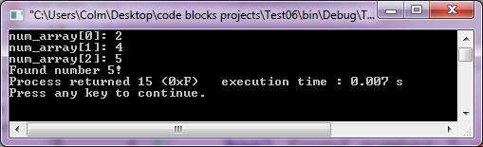
break example
#include <stdbool.h>
int main() {
bool found_number_5 = false;
int num_array[7] = {2, 4, 5, 1, 2, 9, 8};
int i;
for (i = 0; i < 7; ++i) {
printf("num_array[%d]: %d\n", i, num_array[i]);
if (num_array[i] == 5) {
found_number_5 = true;
break;
}
}
if (found_number_5 == true) {
printf("Found number 5!");
}
}

Slide 162
continue
keyword that skip the remainder of the current iteration of a while or for loop regardless of guard condition state
useful for when we want to apply statemets to a subset of a collection e.g. an array

Slide 163
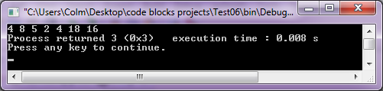
continue example
#include <stdbool.h>
// multiply all elements by 2 except for
// the number 5
int main() {
int num_array[7] = {2, 4, 5, 1, 2, 9, 8};
int i;
for (i = 0; i < 7; ++i) {
if (num_array[i] == 5) {
continue;
}
num_array[i] *= 2;
}
// display the array after multiplication
for (i = 0; i < 7; ++i) {
printf("%d ", num_array[i]);
}
}

Slide 164
nested for loop
a for loop can be placed inside another for loop
- this is called a nested for loop
nested for loops are particularly useful when using arrays
consider that use values from one array against another array

Slide 165
nested for loop example
#include <stdio.h>
#include <stdlib.h>
int main()
{
int odd_array[3] = {1, 3, 5};
int even_array[3] = {2, 4, 6};
int odd_index;
int even_index;
int total_product;
for (odd_index = 0; odd_index < 3; ++odd_index) {
total_product = 0;
printf("odd_index: %d\n", odd_index);
printf("odd_array[odd_index]: %d\n", odd_array[odd_index]);
for (even_index = 0; even_index < 3; ++even_index) {
printf("even_index: %d\n", even_index);
printf("even_array[even_index]: %d\n", even_array[even_index]);
total_product += odd_array[odd_index] * even_array[even_index];
}
printf("total_product: %d\n", total_product);
}
return 0;
}

Slide 166
random number generation
generate a random number
should be seeded to make number more random
only need to seed generator once
can be constrained
http://www.cplusplus.com/reference/clibrary/cstdlib/rand/

Slide 167
random number generation
int v1 = rand() % 100; // v1 in the range 0 to 99
int v2 = (rand() % 100) + 1; // v2 in the range 1 to 100
int v3 = (rand() % 30) + 1985; // v3 in the range 1985-2014
float v4 = (float)rand()/(float)RAND_MAX; // from 0 to 1
// RAND_MAX is a predefined variable: 32767

Slide 168
random number generation
#include <stdio.h>
#include <stdlib.h>
#include <time.h>
int main() {
srand(time(NULL)); // seed the generator
int v1 = (rand() % 10) + 1; // generate number
printf("v1: %d", v1); // display random number
return 0;
}

Slide 169
random number generation exercise 1
Try to guess the secret integer. The secret integer should be selected randomly at the beginning of the program and should have a value from 1 to 10. Have the user guess the secret number. If the guess is too low, output “higher”. Output “lower” if their guess is too high.

Slide 170
solution
#include <stdio.h>
#include <stdlib.h>
#include <time.h>
int main() {
srand(time(NULL)); // seed the generator
int guess = -1;
int secret_number = (rand() % 10) + 1; // generate number
while (guess != secret_number) {
printf("\nEnter your guess of the secret number from 1 to 10: ");
scanf("%d", &guess);
if (guess > secret_number) {
printf("Too high!");
} else if (guess < secret_number) {
printf("Too low!");
}
}
printf("You guessed correctly!");
return 0;
}

Slide 171
random number generation exercise 2
Populate an array with ten random numbers from 1 to 5. Take an integer from the user. Display the values in the array and inform the user whether or not that integer is present in the array.

Slide 172
solution
#include <stdio.h>
#include <stdlib.h>
#include <time.h>
#include <stdbool.h>
int main() {
srand(time(NULL)); // seed the generator
int user_input;
int num_array[10];
bool found_number_in_array = false;
int i;
for (i = 0; i < 10; ++i) {
num_array[i] = (rand() % 5) + 1;
printf("%d ", num_array[i]);
}
printf("\nEnter a number you wish to check is in the array: ");
scanf("%d", &user_input);
for (i = 0; i < 10; ++i) {
if (num_array[i] == user_input) {
found_number_in_array = true;
}
}
if (found_number_in_array == false) {
printf("%d was not present in the array", user_input);
} else {
printf("%d was present in the array", user_input);
}
return 0;
}

Slide 173
random number generation exercise 3
Populate an array with three random booleans. Display the values of the array. State whether or not exactly two of the booleans are true.
hint: a boolean is 0 or 1.

Slide 174
random number generation exercise 4
Keep generating random numbers from 1 to 100 until the same random number has been generated twice.
hint: you can use two arrays - one for the random numbers and one for whether or not that number has already been generated.

Slide 175
random number generation exercise 5
Populate an array with ten integers. Display how many of the numbers are even and how many are odd.

Slide 176
random number generation exercise 6
Populate an array with ten random integers from 1 to 10. Output how many times each number from 1 to 10 occurs in the array e.g. “The number 1 occurs 2 times”, “The number 2 occurs 1 time”. “The number 3 does not occur.” etc.
hint: you can use two arrays - one for the random numbers and one for how many times each occurs.

Slide 177
Unit 3 – Character and String Processing

Slide 178
character set
In this case:
an encoding that maps byte long sequences of bits to symbols, including letters, numbers, punctuation and more.
life before a standard set

Slide 179
US-ASCII
American Standard Code for Information Interchange
A standard character set for representing characters from the English alphabet
128 characters
1 byte – 7 bits for character – 1 for parity

Slide 180
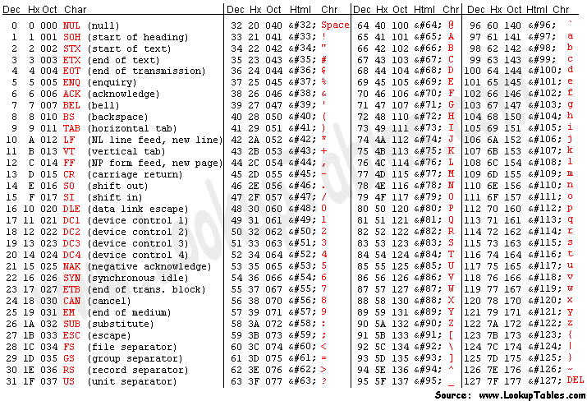
US-ASCII table

Slide 181
US-ASCII table
ordinal set – a set with a kind of order structure applied to it
the set of months in a year
the set of values in the ASCII table is an ordinal set because each is associated with a character
32 unprintable characters followed by 96 printable characters

Slide 182
control characters
Control characters are characters reserved for special behaviour
C has mapped certain control characters to elements in the US-ASCII table
character | effect
\n | line feed
\r | carriage return
\a | alert (beep) – OS specific
\t | horizontal tab
\0 | null
put them inside a printf function and see what happens

Slide 183
extended ASCII
ASCII later unofficially extended to non-English characters as a superset
used for glyphs such as áéíóú£
used the last parity bit to create 128 more characters
many different standards
ISO Latin-1

Slide 184
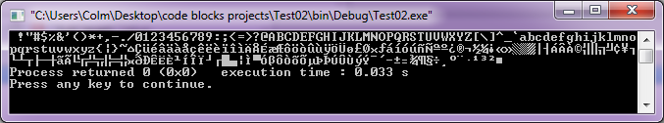
extended ASCII
display the extended character set
#include <stdio.h>
int main() {
int c;
for (c = 32; c <= 255; c++) {
printf("%c", c);
}
return 0;
}

Slide 185
char
a data type that can represent any extended ASCII character
the smallest addressable unit in C
one byte in size
enclosed in single quotes: ‘x’

Slide 186
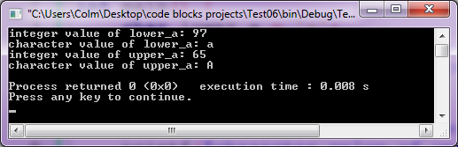
char example 1
int main() {
char lower_a = 'a';
printf("integer value of lower_a: %d \n", lower_a);
printf("character value of lower_a: %c \n", lower_a);
char upper_a = 'A';
printf("integer value of upper_a: %d \n", upper_a);
printf("character value of upper_a: %c \n", upper_a);
return 0;
}

Slide 187
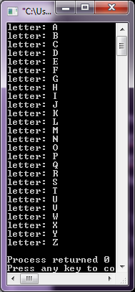
char example 2
// print the alphabet
int main() {
int ascii_upper_case_alphabet_start = 65;
int ascii_upper_case_alphabet_end = 90;
char letter;
// For loop arguments put onto separate lines
// to fit onto the slide in a readable fashion!
for (letter = ascii_upper_case_alphabet_start;
letter <= ascii_upper_case_alphabet_end;
letter++) {
printf("letter: %c \n", letter);
}
return 0;
}

Slide 188
char problem 1
Print out the following using only integers and %c: “Tom & Jerry!”.
e.g. printf("%c%c%c%c", 67, 111, 108, 109);

Slide 189
solution
int main() {
printf("%c%c%c%c%c%c%c%c%c%c%c%c", 84, 111, 109, 32, 38, 32, 74, 101, 114, 114, 121, 33);
return 0;
}

Slide 190
char problem 2
Write a program that takes a letter between ‘A’ and ‘F’. If the letter is any from ‘A’ to ‘D’, print “You passed.”. If it’s ‘F’, print ‘You failed’.

Slide 191
solution
int main() {
char grade;
printf("Enter grade: ");
scanf("%c", &grade);
if (grade >= 'A' && grade <= 'D') {
printf("\nYou passed.");
} else if (grade == 'F') {
printf("\nYou failed.");
}
return 0;
}

Slide 192
char problem 3
Write a program to convert an uppercase letter to lowercase and display it. Do not use the standard library functions.
Hint: The characters are just numbers interpreted by the ASCII table.

Slide 193
solution
int main() {
char uppercase = 'A';
char lowercase = uppercase + 32;
printf("Upper case: %c \n", uppercase);
printf("Lower case: %c", lowercase);
return 0;
}

Slide 194
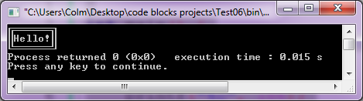
drawing graphical shapes
int main() {
printf("%c%c%c%c%c%c%c%c", 201, 205, 205, 205, 205, 205, 205, 187);
printf("\n%c", 186); // side bar beside 'H'
printf("Hello!");
printf("%c", 186);
printf("\n%c%c%c%c%c%c%c%c", 200, 205, 205, 205, 205, 205, 205, 188);
return 0;
}

Slide 195
character relational operators
<, <=, ==, >, >=, !=
all compare against the character ASCII number

Slide 196
string definition
“A sequence of data values, usually bytes, which usually stand for characters (a ‘character string’). The mapping between values and characters is determined by the character set which is itself specified implicitly or explicitly by the environment in which the string is being interpreted.”
- Free On-Line Dictionary Of Computing

Slide 197
c string (null terminated string)
an array of characters
char name[5] = “Colm”; // implicit null
char name[] = {'C','o','l','m','\0'};
the last character in the array is the null character (‘\0’)
characters use single quotes: ‘x’, strings use double quotes: “xyz”
name
values
‘C’
‘o’
3
‘l’
‘m’
‘\0’
indices
0
1
2
3
4

Slide 198
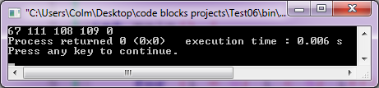
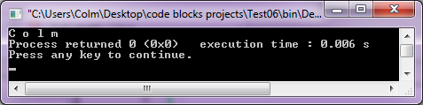
c string under the hood
int main()
{
char name[5] = "Colm";
int i;
for (i = 0; i < 5; i++) {
printf("%d ", name[i]);
}
return 0;
}
int main()
{
char name[5] = "Colm";
int i;
for (i = 0; i < 5; i++) {
printf("%c ", name[i]);
}
return 0;
}

Slide 199
printing a c string
int main()
{
char name[5] = "Colm";
// method one
// print each character
int i;
for (i = 0; i < 5; i++) {
printf("%c", name[i]);
}
printf("\n");
// method two
// print them all at once with a %s token
printf("%s", name);
return 0;
}

Slide 200
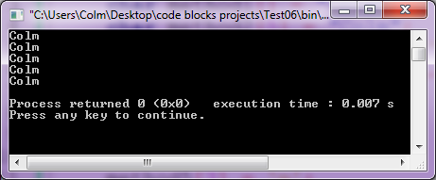
c string initialization
int main() {
char method1[] = "Colm";
char method2[5] = "Colm";
char method3[] = {'C','o','l','m','\0'};
char method4[5] = {'C','o','l','m','\0'};
char method5[5];
method5[0] = 'C';
method5[1] = 'o';
method5[2] = 'l';
method5[3] = 'm';
method5[4] = '\0';
printf("%s \n", method1);
printf("%s \n", method2);
printf("%s \n", method3);
printf("%s \n", method4);
printf("%s \n", method5);
return 0;
}

Slide 201
length, size and dimension of c string
length – the number of characters before the null character
size – the number of bytes in the array
dimension – the number of indices needed to access a character in the array (we only deal with one dimensional arrays)

Slide 202
useful c string functions
strlen – find the length of a string
strcpy – copy string to one place from another
strcat – append one string to another
strcmp – compare two strings for equality
memcpy – copy a block of memory
http://www.cplusplus.com/reference/cstring/

Slide 203
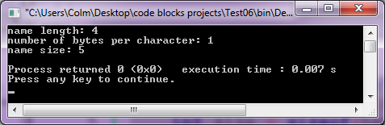
proving implicit null in c string
int main() {
char name[5] = "Colm"; // implicitly appending null
int length = strlen(name);
int size = sizeof(name);
printf("name length: %d \n", length);
printf("number of bytes per character: %d \n", sizeof(char));
printf("name size: %d \n", size);
return 0;
}

Slide 204
c string problem 1
Populate a character array with your name forwards. Print out your name backwards by traversing the array in reverse.

Slide 205
solution
int main() {
char name[] = "Colm";
int i;
// -1 so we don't print out the null character
for (i = strlen(name) - 1; i >= 0; --i) {
printf("%c", name[i]);
}
return 0;
}

Slide 206
c string problem 2
Write a program to change the first letter of the word “happy” to a ‘z’, giving “zappy”, and print it to the screen. Do this by first filling a character array with “happy”.

Slide 207
solution
int main() {
char word[] = "happy";
printf("%s \n", word);
word[0] = 'z';
printf("%s", word);
return 0;
}

Slide 208
c string problem 3
Write a program to count the how many times the letter ‘s’ occurs in the word “Mississippi”.

Slide 209
solution
int main() {
char word[] = "Mississippi";
int num_s = 0;
int i;
for (i = 0; i < strlen(word); ++i) {
if (word[i] == 's') {
++num_s;
}
}
printf("Number of s letters in %s is %d", word, num_s);
return 0;
}

Slide 210
c string problem 4
Write a program to count the length of a string given by the user.
Hint: The null character ‘\0’ appears at the end of each string.

Slide 211
solution
int main() {
char word[100]; // reserve 100 characters in memory for input
int length = 0;
printf("Enter word: ");
scanf("%s", &word);
int i;
for (i = 0; i < strlen(word); ++i) {
if (word[i] != '\0') {
++length;
}
}
printf("Number of characters in %s is %d", word, length);
return 0;
}

Slide 212
c string problem 5
Write a program to count how many times any one letter supplied by the user occurs in the word “happy”.

Slide 213
solution
int main() {
char word[] = "happy";
int num_occurrences = 0;
char user_input;
printf("Enter a character: ");
scanf("%c", &user_input);
int i;
for (i = 0; i < strlen(word); ++i) {
if (word[i] == user_input) {
++num_occurrences;
}
}
printf("%c occurs %d time(s) in 'happy'", user_input, num_occurrences);
return 0;
}

Slide 214
c string problem 6
Write a program to replace all occurrences of the ‘i’ with ‘a’ in the word “Mississippi”.

Slide 215
solution
int main() {
char word[] = "Mississippi";
int i;
for (i = 0; i < strlen(word); ++i) {
if (word[i] == 'i') {
word[i] = 'a';
}
}
printf("%s", word);
return 0;
}

Slide 216
c string problem 7
Write a program to count the number of differences between the strings “10001011” and “11001010”.

Slide 217
solution
int main() {
int num_differences = 0;
char bits1[] = "10001011";
char bits2[] = "11001010";
int i;
for (i = 0; i < strlen(bits1); ++i) {
if (bits1[i] != bits2[i]) {
++num_differences;
}
}
printf("The number of differences between %s and %s is %d",
bits1, bits2, num_differences);
return 0;
}

Slide 218
combining two c strings 1
// using non-string specific memcpy
int main() {
char x[] = "happy";
char y[] = "Mississippi";
char z[18];
int xLen = strlen(x);
int yLen = strlen(y);
int i;
memcpy(z, x, sizeof(x));
z[xLen] = ' ';
memcpy(z + xLen + 1, y, sizeof(y));
z[xLen + yLen + 1] = '\0';
printf("%s\n", z);
return 0;
}

Slide 219
combining two c strings 2
// using string specific functions
int main() {
char x[] = "happy";
char y[] = "Mississippi";
char z[18];
strcpy(z, x);
strcat(z, " ");
strcat(z, y);
printf("%s\n", z);
return 0;
}

Slide 220
print out file contents
#include <stdio.h> // we need this include file
int main() {
char line[80]; // will hold line of text from file
FILE *my_file; // our file variable
// C:\\animals.txt is the absolute file name
// NOTE THE DOUBLE BACK SLASH!
// "r" means open the file for reading text
my_file = fopen("C:\\animals.txt", "r"); // open the file for reading
// Tell the user if the file wasn't found
if (my_file == NULL) {
printf("Error: File not found.");
return 2; // file not found error code
}
// get a line, up to 80 chars from fr. done if NULL
// note that a carriage return will be read too
while(fgets(line, 80, my_file) != NULL) { // NULL terminates the reading
printf("Animal: %s", line);
}
fclose(my_file); // close the file
return 0;
}

Slide 221
File
char line[80]; // will hold line of text from file
FILE *my_file; // our file variable
Make sure that the “line” variable has enough space for however long a line of text in the file may be
“File” is a new type of variable
The asterisk ‘*’, or “star”, is required
The star indicates that “my_file” is a pointer to a file instead of an actual file
We won’t cover pointers at this time

Slide 222
fopen
my_file = fopen("C:\\animals.txt", "r");
fopen is a function that opens files
fopen needs the file location and file mode
‘r’ means read only, ‘w’ is write only. List of all modes: http://www.cplusplus.com/reference/cstdio/fopen/
file location can be relative to the executable or absolute
\\ is needed because \ is a special character and would expect another character e.g. \n

Slide 223
file error detection
if (my_file == NULL) {
printf("Error: File not found.");
return 2; // file not found error code
}
my_file will be NULL if fopen failed
inform user of error
print out system specific error code: http://msdn.microsoft.com/en-us/library/windows/desktop/ms681382(v=vs.85).aspx

Slide 224
read and print file contents
while(fgets(line, 80, my_file) != NULL) {
printf("Animal: %s", line);
}
keep reading from the file while there’s some line to be read, then print that line
fgets takes a character array (line) and fills it with the first 79 characters, in this case (79 characters and a null character at the end), from the file
fgets reads until newline or end-of-file is found

Slide 225
fclose
fclose(my_file); // close the file
close the file you opened, preferably in the same scope (covered later)
frees up resources
not closing can cause crashes

Slide 226
print out file contents (cleaned up)
#include <stdio.h> // we need this include file
int main() {
char line[80]; // will hold line of text from file
FILE *my_file; // our file variable
my_file = fopen("C:\\animals.txt", "r"); // open the file for reading
if (my_file == NULL) { // Tell the user if the file wasn't found
printf("Error: File not found.");
return 2; // file not found error code
}
while(fgets(line, 80, my_file) != NULL) { // NULL terminates the reading
printf("Animal: %s", line);
}
fclose(my_file); // close the file
return 0;
}

Slide 227
animals.txt
ape
bull
cow
duck
elk
frog
goat
hare
iguana
jackal
koala
lion
mole
newt
ox
pig
quail
ram
seal
tiger
viper
whale
yak
zebra
save into your C drive so it is located at C:\animals.txt

Slide 228
c string problem 9
Write a program to display every second animal in animals.txt

Slide 229
c string problem 10
Write a program to display only animals whose name contain the character ‘e’.

Slide 230
c string problem 11
Write a spell checker program by pretending animals.txt is a dictionary. Have the user enter a word and inform them if that string is present in the file.

Slide 231
c string problem 12
Write a program fills a character array with the ninth word from animals.txt. Use whatever method you like display the word with underscores for consonants but with vowels visible.
The output should look like: i_ua_a

Slide 232
solution
#include <stdio.h>
int main() {
char line[80];
FILE *my_file;
int line_number = 0;
char animal[80];
my_file = fopen("C:\\animals.txt", "r");
if (my_file == NULL) {
printf("Error: File not found.");
return 2;
}
while(fgets(line, 80, my_file) != NULL) {
++line_number;
if (line_number == 9) {
strcpy(animal, line);
int null_index = strlen(animal) - 1;
// replacing the \n from the text line with \0
animal[null_index] = '\0';
}
}
fclose(my_file);
int i;
for (i = 0; i < strlen(animal); ++i) {
if (animal[i] != 'a' && animal[i] != 'e' && animal[i] != 'i' &&
animal[i] != 'o' && animal[i] != 'u') {
animal[i] = '_';
}
}
printf("%s", animal);
return 0;
}

Slide 233
Project Rosalind
attempt problems from project Rosalind if you finished all problems listed in the slides.
http://rosalind.info/problems/list-view/

Slide 234
unit 4 - procedures and functions

Slide 235
procedures
a procedure is an ordered sequence of statements that does not return a value
used to reduce code duplication
used to increase code reusability
used to increase code readability

Slide 236
procedure pseudo-code
void procedure_name() {
// statements to be executed
}
int main() {
procedure_name();
return 0;
}

Slide 237
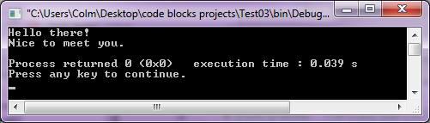
procedure example 1
#include <stdio.h>
#include <stdlib.h>
void greet_user() {
printf("Hello there!\n");
printf("Nice to meet you.\n");
}
int main() {
greet_user();
return 0;
}

Slide 238
procedure example 1
#include <stdio.h>
#include <stdlib.h>
void greet_user() {
printf("Hello there!\n");
printf("Nice to meet you.\n");
}
int main() {
greet_user();
return 0;
}
return variable type
“void” means no value is returned by the function. Procedures, by definition, will always return a “void” type

Slide 239
procedure example 1
#include <stdio.h>
#include <stdlib.h>
void greet_user() {
printf("Hello there!\n");
printf("Nice to meet you.\n");
}
int main() {
greet_user();
return 0;
}
procedure name
we need to associate the procedure with a symbol (name) so it can be called later

Slide 240
procedure example 1
#include <stdio.h>
#include <stdlib.h>
void greet_user() {
printf("Hello there!\n");
printf("Nice to meet you.\n");
}
int main() {
greet_user();
return 0;
}
procedure invocation
call the procedure, telling the program to execute all statements inside it

Slide 241
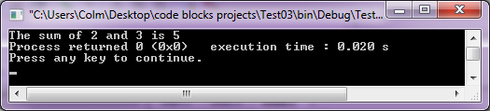
procedure example 2
#include <stdio.h>
#include <stdlib.h>
void display_sum() {
int x = 2;
int y = 3;
int sum = x + y;
printf("The sum of %d and %d is %d", x, y, sum);
}
int main() {
display_sum();
return 0;
}

Slide 242
parameterized procedure pseudo-code
void procedure_name(data_type param1, data_type param2) {
statements to be executed
}
int main() {
data_type some_arg1 = some_value;
data_type some_arg2 = some_value;
procedure_name(some_arg1, some_arg2);
return 0;
}

Slide 243
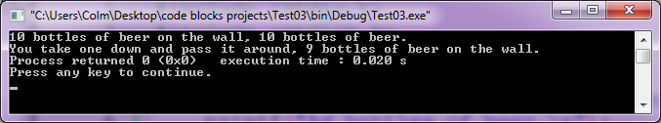
parameterized procedure example
#include <stdio.h>
#include <stdlib.h>
void bottles_lyric(int num_bottles) {
printf("%d bottles of beer on the wall, ", num_bottles);
printf("%d bottles of beer.\n");
printf("You take one down and pass it around, ");
num_bottles--;
printf("%d bottles of beer on the wall.", num_bottles);
}
int main()
{
bottles_lyric(10);
return 0;
}

Slide 244
parameterized procedure example
#include <stdio.h>
#include <stdlib.h>
void bottles_lyric(int num_bottles) {
printf("%d bottles of beer on the wall, ", num_bottles);
printf("%d bottles of beer.\n");
printf("You take one down and pass it around, ");
num_bottles--;
printf("%d bottles of beer on the wall.", num_bottles);
}
int main()
{
bottles_lyric(10);
return 0;
}
parameter type
the procedure needs to know what type of value is being passed into it – int, bool, char etc.

Slide 245
parameterized procedure example
#include <stdio.h>
#include <stdlib.h>
void bottles_lyric(int num_bottles) {
printf("%d bottles of beer on the wall, ", num_bottles);
printf("%d bottles of beer.\n");
printf("You take one down and pass it around, ");
num_bottles--;
printf("%d bottles of beer on the wall.", num_bottles);
}
int main()
{
bottles_lyric(10);
return 0;
}
matching data type
the data type of the argument must be the same as the data type of the parameter

Slide 246
parameterized procedure example
#include <stdio.h>
#include <stdlib.h>
void bottles_lyric(int num_bottles) {
printf("%d bottles of beer on the wall, ", num_bottles);
printf("%d bottles of beer.\n");
printf("You take one down and pass it around, ");
num_bottles--;
printf("%d bottles of beer on the wall.", num_bottles);
}
int main()
{
bottles_lyric(10);
return 0;
}
parameter name
The name of a new variable we created. It will be assigned the value of the argument given to it.

Slide 247
parameterized procedure example
#include <stdio.h>
#include <stdlib.h>
void bottles_lyric(int num_bottles) {
printf("%d bottles of beer on the wall, ", num_bottles);
printf("%d bottles of beer.\n");
printf("You take one down and pass it around, ");
num_bottles--;
printf("%d bottles of beer on the wall.", num_bottles);
}
int main()
{
bottles_lyric(10);
return 0;
}
parameterized procedure call
The procedure is called with the argument of value 10, which will be assigned to the num_bottles parameter.

Slide 248
parameterized procedure example
#include <stdio.h>
#include <stdlib.h>
void bottles_lyric(int num_bottles) {
printf("%d bottles of beer on the wall, ", num_bottles);
printf("%d bottles of beer.\n");
printf("You take one down and pass it around, ");
num_bottles--;
printf("%d bottles of beer on the wall.", num_bottles);
}
int main()
{
bottles_lyric(10);
bottles_lyric(9);
bottles_lyric(8);
return 0;
}
We can invoke a procedure as many times as we like.

Slide 249
parameterized procedure exercise 1
Output the lyrics to the “bottle of beer on the wall” song using a for loop. Start with 10 bottles of beer on the wall and end with 0.

Slide 250
parameterized procedure solution 1
#include <stdio.h>
#include <stdlib.h>
void bottles_lyric(int num_bottles) {
printf("%d bottles of beer on the wall, ", num_bottles);
printf("%d bottles of beer.\n");
printf("You take one down and pass it around, ");
num_bottles--;
printf("%d bottles of beer on the wall.", num_bottles);
}
int main() {
int i;
for (i = 10; i > 0; i--) {
bottles_lyric(i);
}
return 0;
}

Slide 251
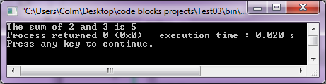
parameterized procedure example
#include <stdio.h>
#include <stdlib.h>
void display_sum(int x, int y) {
int sum = x + y;
printf("The sum of %d and %d is %d", x, y, sum);
}
int main() {
display_sum(2,3);
return 0;
}

Slide 252
parameterized procedure example
#include <stdio.h>
#include <stdlib.h>
void display_sum(int x, int y) {
int sum = x + y;
printf("The sum of %d and %d is %d", x, y, sum);
}
int main() {
display_sum(2,3);
return 0;
}
positional parameters
Parameters are given values based on argument position. The first argument in the procedure call is assigned to the first parameter. The second argument is assigned to the parameter.

Slide 253
parameterized procedure example
#include <stdio.h>
#include <stdlib.h>
void display_sum(int x, int y) {
int sum = x + y;
printf("The sum of %d and %d is %d", x, y, sum);
}
void display_product (int factor1, int factor2) {
int product = factor1 * factor2;
printf("\nThe product of %d and %d is %d", factor1, factor2, product);
}
void display_calculations(int a, int b) {
display_sum(a, b);
display_product(a, b);
}
int main() {
display_calculations(2,3);
return 0;
}
We can call procedures inside other procedures

Slide 254
parameterized procedure exercise 2
Write a procedure that takes one integer as input and informs the user of the square of that number. The procedure should have the number to be squared as its only parameter.

Slide 255
parameterized procedure solution 2
#include <stdio.h>
#include <stdlib.h>
void display_square(int x) {
printf("The square of %d is %d", x, x * x); // x * x is an inline calculation
}
int main() {
int i;
int user_input;
printf("Enter an integer to be squared: ");
scanf("%d", &user_input);
display_square(user_input);
return 0;
}

Slide 256
parameterized procedure exercise 3
Write a procedure that takes two integers as input and informs the user which is smaller.

Slide 257
parameterized procedure solution 3
#include <stdio.h>
#include <stdlib.h>
void find_smallest(int x, int y) {
if (x > y) {
printf("%d is smaller than %d", y, x);
} else if (y > x) {
printf("%d is smaller than %d", x, y);
} else {
printf("%d is the same as %d", x, y);
}
}
int main() {
int i;
int user_input1;
int user_input2;
printf("Enter the first integer: ");
scanf("%d", &user_input1);
printf("Enter the second integer: ");
scanf("%d", &user_input2);
find_smallest(user_input1, user_input2);
return 0;
}

Slide 258
parameterized procedure exercise 4
Write a procedure that takes one integer as input and informs the user of that integers absolute value.

Slide 259
parameterized procedure solution 4
#include <stdio.h>
#include <stdlib.h>
void display_absolute_value(int x) {
if (x < 0) {
printf("The absolute value of %d is %d", x, x * -1);
} else {
printf("The absolute value of %d is %d", x, x);
}
}
int main() {
int i;
int user_input;
printf("Enter an integer: ");
scanf("%d", &user_input);
display_absolute_value(user_input);
return 0;
}

Slide 260
functions
a function is an ordered sequence of statements that does return a value
a procedure can be thought of a function that can only return void
functions are the building blocks of code
Without procedures and functions, code becomes very difficult to manage because of a lack of structure and massive duplication of effort

Slide 261
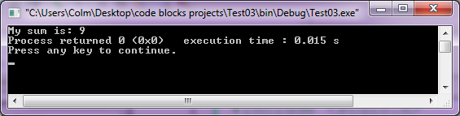
function example 1
#include <stdio.h>
#include <stdlib.h>
int sum(int x, int y, int z) {
int a = x + y + z;
return a;
}
int main() {
int my_sum = sum(2, 3, 4);
printf("My sum is: %d", my_sum);
return 0;
}

Slide 262
function example 1
#include <stdio.h>
#include <stdlib.h>
int sum(int x, int y, int z) {
int a = x + y + z;
return a;
}
int main() {
int my_sum = sum(2, 3, 4);
printf("My sum is: %d", my_sum);
return 0;
}
The function will return a variable of type “int”. Other types include float and bool.

Slide 263
function example 1
#include <stdio.h>
#include <stdlib.h>
int sum(int x, int y, int z) {
int a = x + y + z;
return a;
}
int main() {
int my_sum = sum(2, 3, 4);
printf("My sum is: %d", my_sum);
return 0;
}
Call the “sum” function, passing three arguments. This evaluates the function.

Slide 264
function example 1
#include <stdio.h>
#include <stdlib.h>
int sum(int x, int y, int z) {
int a = x + y + z;
return a;
}
int main() {
int my_sum = sum(2, 3, 4);
printf("My sum is: %d", my_sum);
return 0;
}
The arguments are assigned to the parameters.

Slide 265
function example 1
#include <stdio.h>
#include <stdlib.h>
int sum(int x, int y, int z) {
int a = x + y + z;
return a;
}
int main() {
int my_sum = sum(2, 3, 4);
printf("My sum is: %d", my_sum);
return 0;
}
The sum is obtained by adding all of the parameters together. The value of the sum is returned to where it was called from using the “return” keyword.

Slide 266
function example 1
#include <stdio.h>
#include <stdlib.h>
int sum(int x, int y, int z) {
int a = x + y + z;
return a;
}
int main() {
int my_sum = sum(2, 3, 4);
printf("My sum is: %d", my_sum);
return 0;
}
In this instance, the “sum” function will return an integer of value 9. The value of my_sum will be set to 9.

Slide 267
function example 1
#include <stdio.h>
#include <stdlib.h>
int sum(int x, int y, int z) {
int a = x + y + z;
return a;
}
int main() {
int my_sum = sum(2, 3, 4);
printf("My sum is: %d", my_sum);
return 0;
}
The return type, function name, number of parameters and parameter types make up a function signature.

Slide 268
function example 1
#include <stdio.h>
#include <stdlib.h>
int sum(int x, int y, int z) {
int a = x + y + z;
return a;
}
int main() {
int my_sum = sum(2, 3, 4);
printf("My sum is: %d", my_sum);
return 0;
}
Everything that the function does is referred to as the function definition.

Slide 269
function example 2
#include <stdio.h>
#include <stdlib.h>
int add(int x, int y) {
return x + y;
}
int main() {
int a = 2;
int b = 3;
int sum = add(a, b);
printf("The sum of %d and %d is %d", a, b, sum);
return 0;
}

Slide 270
argument order matters
#include <stdio.h>
#include <stdlib.h>
int subtract(int x, int y) {
return x - y;
}
int main() {
int a = 5;
int b = 3;
int result = subtract(a, b); // subtract(b, a) would give -2
printf("The result of %d minus %d is %d", a, b, result);
return 0;
}

Slide 271
function example 3
#include <stdio.h>
#include <stdlib.h>
#include <stdbool.h>
bool is_even(int x) {
if (x % 2 == 0) {
return true;
} else {
return false;
}
}
int main() {
int user_input;
printf("Enter an integer: ");
scanf("%d", &user_input);
bool user_input_is_even = is_even(user_input);
if (user_input_is_even == true) {
printf("%d is even", user_input);
} else {
printf("%d is odd", user_input);
}
return 0;
}

Slide 272
user defined and standard functions
standard functions are in the include files
printf, scanf
user-defined function are created by the user
is_even, subtract, sum

Slide 273
scope of variables
“[A] scope is the context within a computer program in which a variable name or other identifier is valid and can be used.”
- Wikipedia
function scope
block scope
file scope
program/global scope

Slide 274
C function conventions
a function should be named according to what they do
if it’s hard to accurately name a function, it probably means it’s doing too much and should be broken into multiple functions
follow the verb_name system when possible e.g. get_lives, load_file
functions should be no longer than n statements where n is defined in style guide
consider that webkit functions contain on average 2.1 statements, firefox 6.7 and IE 7.1
http://aptiverse.com/blog/closer_look_at_chrome/

Slide 275
function scope
a variable has function scope if it is enclosed in braces {} immediately after a function signature
int main() {
int i; //function scope
i = 0;
printf("i: %d", i); // i is still accessible here
return 0;
}

Slide 276
function scope
#include <stdio.h>
#include <stdlib.h>
void foo(int i) { // function scope
i = 1; // this is a different variable by the same name
printf("inside foo i: %d \n", i);
}
int main() {
int i; //function scope
i = 0;
foo(i); // passes a copy of i
printf("inside main i: %d", i); // main i is still accessible here
return 0;
}

Slide 277
block scope
a variable has block scope if it is enclosed in brace {}
#include <stdio.h>
#include <stdlib.h>
int main() {
int i; //function scope
for (i = 0; i < 3; i++) { // start for loop block scope
int j = i * 2; // j has block scope
printf("for loop block j: %d\n", j);
} // end for loop block scope
printf("main function i: %d", i);
printf("main function j: %d", j); // this won't work. j is out of scope
return 0;
}

Slide 278
file scope
a variable has file scope if it is outside of a function and is preceded by the keyword “static”

Slide 279
file scope
#include <stdio.h>
#include <stdlib.h>
static int my_file_scope_var = 9; // has file scope
void foo(int i) { // i has foo function scope
i++;
printf("foo i: %d \n", i);
printf("foo my_file_scope_var: %d \n", my_file_scope_var);
}
int main() {
int i; //main function scope
for (i = 0; i < 3; i++) { // start for loop block scope
int j = i * 2; // j has block scope
printf("for loop block j: %d\n", j);
} // end for loop block scope
foo(i);
printf("main function i: %d \n", i);
printf("main my_file_scope_var: %d \n", my_file_scope_var);
return 0;
}

Slide 280
program/global scope
a variable has program or global scope if it is outside of a function and is not preceded by the keyword “static”

Slide 281
program/global scope
#include <stdio.h>
#include <stdlib.h>
static int my_file_scope_var = 9; // has file scope
int my_global_scope_var = 10; // has program/global scope
void foo(int i) { // i has foo function scope
i++;
printf("foo i: %d \n", i);
printf("foo my_file_scope_var: %d \n", my_file_scope_var);
printf("foo my_global_scope_var: %d \n", my_global_scope_var);
}
int main() {
int i; //function scope
for (i = 0; i < 3; i++) { // start for loop block scope
int j = i * 2; // j has block scope
printf("for loop block j: %d\n", j);
} // end for loop block scope
foo(i);
printf("main function i: %d \n", i);
printf("main my_file_scope_var: %d \n", my_file_scope_var);
printf("main my_global_scope_var: %d \n", my_global_scope_var);
return 0;
}

Slide 282
scope example
int my_global = 70; // never goes out of scope
int add(int x, int y) {
int sum = x + y;
return sum;
} // sum goes out of scope (function scope)
int multiply(int factor1, int factor2) {
int product = factor1 * factor2;
return product;
} // product goes out of scope (function scope)
void display_calculations(int a, int b) {
int add_result = add(a, b);
int multiply_result = multiply(a, b);
printf("Result of addition: %d\n", add_result);
printf("Result of multiplication: %d\n", multiply_result);
} // add_result and multiply_result go out of scope (function scope)
int main() {
int num1 = 2;
int num2 = 3;
display_calculations(num1, num2);
int i = 0;
while (i != num2) {
int block_scope_var = i * 5;
++i;
printf("Block scope variable: %d\n", block_scope_var);
} // block_scope_var goes out of scope
printf("Global scope variable: %d", my_global);
return 0;
} // i, num1 and num2 go out of scope (function scope)

Slide 283
call stack
A stack data structure used to store information about active functions.
Think of a stack of books. The one at the top should be removed before the second from top.
First-in, last out.
Note that the following example will not show standard functions like printf being placed on the stack, though they are.

Slide 284
stack example
int my_global = 70; // never goes out of scope
int add(int x, int y) {
int sum = x + y;
return sum;
} // sum goes out of scope (function scope)
int multiply(int factor1, int factor2) {
int product = factor1 * factor2;
return product;
} // product goes out of scope (function scope)
void display_calculations(int a, int b) {
int add_result = add(a, b);
int multiply_result = multiply(a, b);
printf("Result of addition: %d\n", add_result);
printf("Result of multiplication: %d\n", multiply_result);
} // add_result and multiply_result go out of scope (function scope)
int main() {
int num1 = 2;
int num2 = 3;
display_calculations(num1, num2);
int i = 0;
while (i != num2) {
int block_scope_var = i * 5;
++i;
printf("Block scope variable: %d\n", block_scope_var);
} // block_scope_var goes out of scope
printf("Global scope variable: %d", my_global);
return 0;
} // i, num1 and num2 go out of scope (function scope)
Program starts with the main function being pushed onto the call stack.
main
call stack

Slide 285
stack example
int my_global = 70; // never goes out of scope
int add(int x, int y) {
int sum = x + y;
return sum;
} // sum goes out of scope (function scope)
int multiply(int factor1, int factor2) {
int product = factor1 * factor2;
return product;
} // product goes out of scope (function scope)
void display_calculations(int a, int b) {
int add_result = add(a, b);
int multiply_result = multiply(a, b);
printf("Result of addition: %d\n", add_result);
printf("Result of multiplication: %d\n", multiply_result);
} // add_result and multiply_result go out of scope (function scope)
int main() {
int num1 = 2;
int num2 = 3;
display_calculations(num1, num2);
int i = 0;
while (i != num2) {
int block_scope_var = i * 5;
++i;
printf("Block scope variable: %d\n", block_scope_var);
} // block_scope_var goes out of scope
printf("Global scope variable: %d", my_global);
return 0;
} // i, num1 and num2 go out of scope (function scope)
The display_calculations function is pushed onto the stack.
display_calculations
main
call stack

Slide 286
stack example
int my_global = 70; // never goes out of scope
int add(int x, int y) {
int sum = x + y;
return sum;
} // sum goes out of scope (function scope)
int multiply(int factor1, int factor2) {
int product = factor1 * factor2;
return product;
} // product goes out of scope (function scope)
void display_calculations(int a, int b) {
int add_result = add(a, b);
int multiply_result = multiply(a, b);
printf("Result of addition: %d\n", add_result);
printf("Result of multiplication: %d\n", multiply_result);
} // add_result and multiply_result go out of scope (function scope)
int main() {
int num1 = 2;
int num2 = 3;
display_calculations(num1, num2);
int i = 0;
while (i != num2) {
int block_scope_var = i * 5;
++i;
printf("Block scope variable: %d\n", block_scope_var);
} // block_scope_var goes out of scope
printf("Global scope variable: %d", my_global);
return 0;
} // i, num1 and num2 go out of scope (function scope)
The add function is pushed onto the stack.
add
display_calculations
main
call stack

Slide 287
stack example
int my_global = 70; // never goes out of scope
int add(int x, int y) {
int sum = x + y;
return sum;
} // sum goes out of scope (function scope)
int multiply(int factor1, int factor2) {
int product = factor1 * factor2;
return product;
} // product goes out of scope (function scope)
void display_calculations(int a, int b) {
int add_result = add(a, b);
int multiply_result = multiply(a, b);
printf("Result of addition: %d\n", add_result);
printf("Result of multiplication: %d\n", multiply_result);
} // add_result and multiply_result go out of scope (function scope)
int main() {
int num1 = 2;
int num2 = 3;
display_calculations(num1, num2);
int i = 0;
while (i != num2) {
int block_scope_var = i * 5;
++i;
printf("Block scope variable: %d\n", block_scope_var);
} // block_scope_var goes out of scope
printf("Global scope variable: %d", my_global);
return 0;
} // i, num1 and num2 go out of scope (function scope)
The add function is complete and is popped off the stack.
display_calculations
main
call stack

Slide 288
stack example
int my_global = 70; // never goes out of scope
int add(int x, int y) {
int sum = x + y;
return sum;
} // sum goes out of scope (function scope)
int multiply(int factor1, int factor2) {
int product = factor1 * factor2;
return product;
} // product goes out of scope (function scope)
void display_calculations(int a, int b) {
int add_result = add(a, b);
int multiply_result = multiply(a, b);
printf("Result of addition: %d\n", add_result);
printf("Result of multiplication: %d\n", multiply_result);
} // add_result and multiply_result go out of scope (function scope)
int main() {
int num1 = 2;
int num2 = 3;
display_calculations(num1, num2);
int i = 0;
while (i != num2) {
int block_scope_var = i * 5;
++i;
printf("Block scope variable: %d\n", block_scope_var);
} // block_scope_var goes out of scope
printf("Global scope variable: %d", my_global);
return 0;
} // i, num1 and num2 go out of scope (function scope)
The program resumes running the top function on the stack, display_calculations. It continues from the statement after the add function call.
display_calculations
main
call stack

Slide 289
stack example
int my_global = 70; // never goes out of scope
int add(int x, int y) {
int sum = x + y;
return sum;
} // sum goes out of scope (function scope)
int multiply(int factor1, int factor2) {
int product = factor1 * factor2;
return product;
} // product goes out of scope (function scope)
void display_calculations(int a, int b) {
int add_result = add(a, b);
int multiply_result = multiply(a, b);
printf("Result of addition: %d\n", add_result);
printf("Result of multiplication: %d\n", multiply_result);
} // add_result and multiply_result go out of scope (function scope)
int main() {
int num1 = 2;
int num2 = 3;
display_calculations(num1, num2);
int i = 0;
while (i != num2) {
int block_scope_var = i * 5;
++i;
printf("Block scope variable: %d\n", block_scope_var);
} // block_scope_var goes out of scope
printf("Global scope variable: %d", my_global);
return 0;
} // i, num1 and num2 go out of scope (function scope)
The multiply function is pushed onto the stack.
multiply
display_calculations
main
call stack

Slide 290
stack example
int my_global = 70; // never goes out of scope
int add(int x, int y) {
int sum = x + y;
return sum;
} // sum goes out of scope (function scope)
int multiply(int factor1, int factor2) {
int product = factor1 * factor2;
return product;
} // product goes out of scope (function scope)
void display_calculations(int a, int b) {
int add_result = add(a, b);
int multiply_result = multiply(a, b);
printf("Result of addition: %d\n", add_result);
printf("Result of multiplication: %d\n", multiply_result);
} // add_result and multiply_result go out of scope (function scope)
int main() {
int num1 = 2;
int num2 = 3;
display_calculations(num1, num2);
int i = 0;
while (i != num2) {
int block_scope_var = i * 5;
++i;
printf("Block scope variable: %d\n", block_scope_var);
} // block_scope_var goes out of scope
printf("Global scope variable: %d", my_global);
return 0;
} // i, num1 and num2 go out of scope (function scope)
The multiply function is complete and is popped off the stack.
display_calculations
main
call stack

Slide 291
stack example
int my_global = 70; // never goes out of scope
int add(int x, int y) {
int sum = x + y;
return sum;
} // sum goes out of scope (function scope)
int multiply(int factor1, int factor2) {
int product = factor1 * factor2;
return product;
} // product goes out of scope (function scope)
void display_calculations(int a, int b) {
int add_result = add(a, b);
int multiply_result = multiply(a, b);
printf("Result of addition: %d\n", add_result);
printf("Result of multiplication: %d\n", multiply_result);
} // add_result and multiply_result go out of scope (function scope)
int main() {
int num1 = 2;
int num2 = 3;
display_calculations(num1, num2);
int i = 0;
while (i != num2) {
int block_scope_var = i * 5;
++i;
printf("Block scope variable: %d\n", block_scope_var);
} // block_scope_var goes out of scope
printf("Global scope variable: %d", my_global);
return 0;
} // i, num1 and num2 go out of scope (function scope)
The program resumes running the top function on the stack, display_calculations. It continues from the statement after the multiply function call.
display_calculations
main
call stack

Slide 292
stack example
int my_global = 70; // never goes out of scope
int add(int x, int y) {
int sum = x + y;
return sum;
} // sum goes out of scope (function scope)
int multiply(int factor1, int factor2) {
int product = factor1 * factor2;
return product;
} // product goes out of scope (function scope)
void display_calculations(int a, int b) {
int add_result = add(a, b);
int multiply_result = multiply(a, b);
printf("Result of addition: %d\n", add_result);
printf("Result of multiplication: %d\n", multiply_result);
} // add_result and multiply_result go out of scope (function scope)
int main() {
int num1 = 2;
int num2 = 3;
display_calculations(num1, num2);
int i = 0;
while (i != num2) {
int block_scope_var = i * 5;
++i;
printf("Block scope variable: %d\n", block_scope_var);
} // block_scope_var goes out of scope
printf("Global scope variable: %d", my_global);
return 0;
} // i, num1 and num2 go out of scope (function scope)
The display_calculation function is complete and is popped off the stack.
main
call stack

Slide 293
stack example
int my_global = 70; // never goes out of scope
int add(int x, int y) {
int sum = x + y;
return sum;
} // sum goes out of scope (function scope)
int multiply(int factor1, int factor2) {
int product = factor1 * factor2;
return product;
} // product goes out of scope (function scope)
void display_calculations(int a, int b) {
int add_result = add(a, b);
int multiply_result = multiply(a, b);
printf("Result of addition: %d\n", add_result);
printf("Result of multiplication: %d\n", multiply_result);
} // add_result and multiply_result go out of scope (function scope)
int main() {
int num1 = 2;
int num2 = 3;
display_calculations(num1, num2);
int i = 0;
while (i != num2) {
int block_scope_var = i * 5;
++i;
printf("Block scope variable: %d\n", block_scope_var);
} // block_scope_var goes out of scope
printf("Global scope variable: %d", my_global);
return 0;
} // i, num1 and num2 go out of scope (function scope)
The program resumes running the top function on the stack, main. It continues from the statement after the display_calculations function call.
main
call stack

Slide 294
stack example
int my_global = 70; // never goes out of scope
int add(int x, int y) {
int sum = x + y;
return sum;
} // sum goes out of scope (function scope)
int multiply(int factor1, int factor2) {
int product = factor1 * factor2;
return product;
} // product goes out of scope (function scope)
void display_calculations(int a, int b) {
int add_result = add(a, b);
int multiply_result = multiply(a, b);
printf("Result of addition: %d\n", add_result);
printf("Result of multiplication: %d\n", multiply_result);
} // add_result and multiply_result go out of scope (function scope)
int main() {
int num1 = 2;
int num2 = 3;
display_calculations(num1, num2);
int i = 0;
while (i != num2) {
int block_scope_var = i * 5;
++i;
printf("Block scope variable: %d\n", block_scope_var);
} // block_scope_var goes out of scope
printf("Global scope variable: %d", my_global);
return 0;
} // i, num1 and num2 go out of scope (function scope)
The main function is complete and is popped off the stack. The program is terminated when the stack is empty.
call stack

Slide 295
function exercise 1
Write a function that takes two integers as input. The function should return the largest of the two integers. Call this function from the main function and display its output.

Slide 296
function exercise 2
Write a function that converts centimeters to inches. Call this function from the main function and display its output.

Slide 297
function exercise 3
Write a function:
float calculate_bmi(float weight_kg, float height_cm)
that returns the BMI of the user. Use a procedure to tell the user which weight category they are in with the procedure:
void display_bmi_category(float bmi)

Slide 298
function exercise 4
Write a function that converts meters to inches by first converting the meter to centimeters and then reusing the function made in function exercise 2. Call this function from the main function and display its output.

Slide 299
function exercise 5
Write a function that converts upper case characters to lower case and another function that converts lower case characters to upper case.

Slide 300
function exercise 7
Write a function that returns the number of lower case characters in a string.

Slide 301
prototypes
A function signature that the compiler uses to infer what the correct number and type of arguments should be
E.g. char to_upper_case(char guess);
Notice the semi-colon at the end
Always place prototypes at the top of the file in which the function is defined
Although prototypes aren’t needed (for C backward compatibility), it’s best practice to use them

Slide 302
prototype example
// function prototype
char make_lowercase_uppercase(char letter);
// function definition
char make_lowercase_uppercase(char letter) {
return letter - 32; // using our ASCII knowledge
}
int main() {
char lower_letter = 'z';
char upper_letter;
upper_letter = make_lowercase_uppercase(lower_letter);
printf("letter lower case: %c\n", lower_letter);
printf("letter upper case: %c\n", upper_letter);
return 0;
}

Slide 303
passing arrays to a function
C handles the passing of array argument differently to passing a non-array argument
C uses a very efficient but unintuitive and dangerous method

Slide 304
passing an array into a function 1
#include <stdbool.h>
bool is_hello(char array[]) {
int i;
char x[] = "hello";
for (i = 0; i < strlen(array); ++i) {
if (x[i] != array[i]) {
return false;
}
}
// it will only reach this if all characters were the same
return true;
}
int main() {
char array[] = "goodbye";
bool result = is_hello(array);
if (result == false) {
printf("%s is not the same as hello", array);
} else {
printf("%s is the same as hello", array);
}
return 0;
}

Slide 305
passing an array into a function 2
int sum(int array[], int length) {
int i;
int total = 0;
// we needed the length to know how many iterations to perform
for (i = 0; i < length; ++i) {
total += array[i];
}
return total;
}
int main() {
int length = 4;
int array[] = {2, 7, 3, 1};
int result = sum(array, length);
printf("result: %d", result);
return 0;
}

Slide 306
function exercise 5
Write a function that returns the sum of numbers in an array.
Hint: One parameter will be the array, the other will be the size of the array.

Slide 307
receiving arrays from a function
We will use a work-around to avoid some complicated parts of C
So far we’ve covered passing copies of values to a function
this is called passing-by-value
arrays in C are passed-by-reference

Slide 308
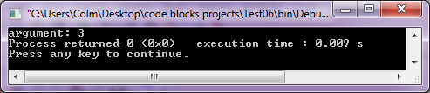
pass-by-value
pass-by-value creates a new variable as the parameter and is given the value of the argument
modifying a passed-by-value parameter does not change the argument
void my_func(int passed_by_value_parameter) {
passed_by_value_parameter = 4;
}
int main() {
int argument = 3;
my_func(argument);
printf("argument: %d", argument);
return 0;
}

Slide 309
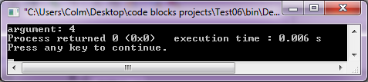
pass-by-reference
pass-by-reference uses the original argument passed to the function
modifying a passed-by-reference parameter changes the argument
void my_func(int passed_by_reference_parameter[]) {
passed_by_reference_parameter[0] = 4;
}
int main() {
int argument[1] = {3};
my_func(argument);
printf("argument: %d", argument[0]);
return 0;
}

Slide 310
transforming an array using a function
void lower_to_upper(char array[]) {
int i;
for (i = 0; i < strlen(array); ++i) {
array[i] -= 32; // using our ASCII table knowledge
}
}
int main() {
char array[] = "hello";
lower_to_upper(array);
printf("Upper hello: %s", array);
return 0;
}

Slide 311
transforming an array using a function
void lower_to_upper(char word[], char buffer[]) {
int i;
strcpy(buffer, word); // copy the contents
for (i = 0; i < strlen(word); ++i) {
buffer[i] -= 32; // using our ASCII table knowledge
}
}
int main() {
char buffer[50];
char word[] = "mississippi";
lower_to_upper(word, buffer);
printf("Lower Mississippi: %s\n", word);
printf("Upper Mississippi: %s\n", buffer);
return 0;
}

Slide 312
function exercise 6
Write a function that accepts a character array and two characters as arguments. Have the function change the input word by replacing all instances of the first character by the second.
e.g. replace(char word[], char to_be_replaced, char replacement)
e.g. replace(“Mississippi”, ‘i’, ‘a’) will transform the word to be “Massassappa”.

Slide 313
function exercise 7
Write a function that mutates a character array to be the opposite casing, i.e. uppercase characters become lowercase, lowercase become uppercase

Slide 314
function exercise 8
Write a function that mutates a character array to be the opposite casing based on the value in the corresponding index of a boolean array. A case switch should be performed is the bolean is true.
int main() {
bool switcher[] = {true, false, true};
char word[] = "cat";
switch_case(word, switcher);
printf("%s", word);
}
This code would cause “word” to become “CaT”.

Slide 315
function exercise 9
Write a function to count the number of times the word “is” occurs within the string “is this the real life? Is this just fantasy?”.

Slide 316
const
keyword to make a variable constant i.e. read only
used to increase code readability
compiler can better optimize code
static code analysers can be more accurate
another compile time error that could be caught

Slide 317
const
must be initialized with the constant value
variable cannot be given a new value after
// no errors
int main() {
const int x = 5;
return 0;
}
// didn’t initialize variable
int main() {
const int x;
x = 5; //error
return 0;
}
// tried to change value
int main() {
const int x = 5;
x = 6; //error
return 0;
}

Slide 318
const
must be initialized with the constant value
variable cannot be given a new value after
// no errors
int main() {
const int x = 5;
return 0;
}
// didn’t initialize variable
int main() {
const int x;
x = 5; //error
return 0;
}
// tried to change value
int main() {
const int x = 5;
x = 6; //error
return 0;
}

Slide 319
when to use const
From the Google Style Guide
“If a function does not modify an argument passed by reference or by pointer, that argument should be const.”
“Consider making data members const whenever they do not need to be modified after construction.”

Slide 320
const example 1
//demonstrate how const might be used
// parameters that don't change should be const
int add(const int x, const int y) {
return x + y;
}
int main() {
int my_var1 = 3;
int my_var2 = 4;
const int my_const1 = 7;
const int my_const2 = 8;
// sum doesn't have to be const
int sum1 = add(4, 5);
// but it's more accurate as sum never changes its value
const int sum2 = add(4, 5);
// arguments can be variable or const
// but are always received assigned to const
// parameters in the add function
const int sum3 = add(my_var1, my_var2);
const int sum4 = add(my_const1, my_const2);
const int sum5 = add(my_const1, my_var1);
printf("%d %d %d %d %d", sum1, sum2, sum3, sum4, sum5);
return 0;
}

Slide 321
const example 2
// the return type can also be const but that
//won't make a difference for what we cover
const int add(const int x, const int y) {
return x + y;
}
int main() {
int sum1 = add(4, 5);
sum1 = 2;
const int sum2 = add(6, 7);
printf("%d", sum5);
return 0;
}

Slide 322
const example 3
// the "word" variable shouldn't change but the "buffer" should
void lower_to_upper(const char word[], char buffer[]) {
int i;
strcpy(buffer, word); // copy the contents
for (i = 0; i < strlen(word); ++i) {
buffer[i] -= 32; // using our ASCII table knowledge
}
}
int main() {
char buffer[50];
const char word[] = "mississippi";
lower_to_upper(word, buffer);
printf("Lower Mississippi: %s\n", word);
printf("Upper Mississippi: %s\n", buffer);
return 0;
}
notice how we have a better idea of what the function does and doesn’t do (doesn’t change word) just by reading the function signature

Slide 323
const exercise
go back all through exercises done in units 3 and 4 and add the const keyword where it is appropriate

Slide 324
Project Euler
For those who are finished everything in this class
register and solve problems
projecteuler.net/problems

